Slide 1
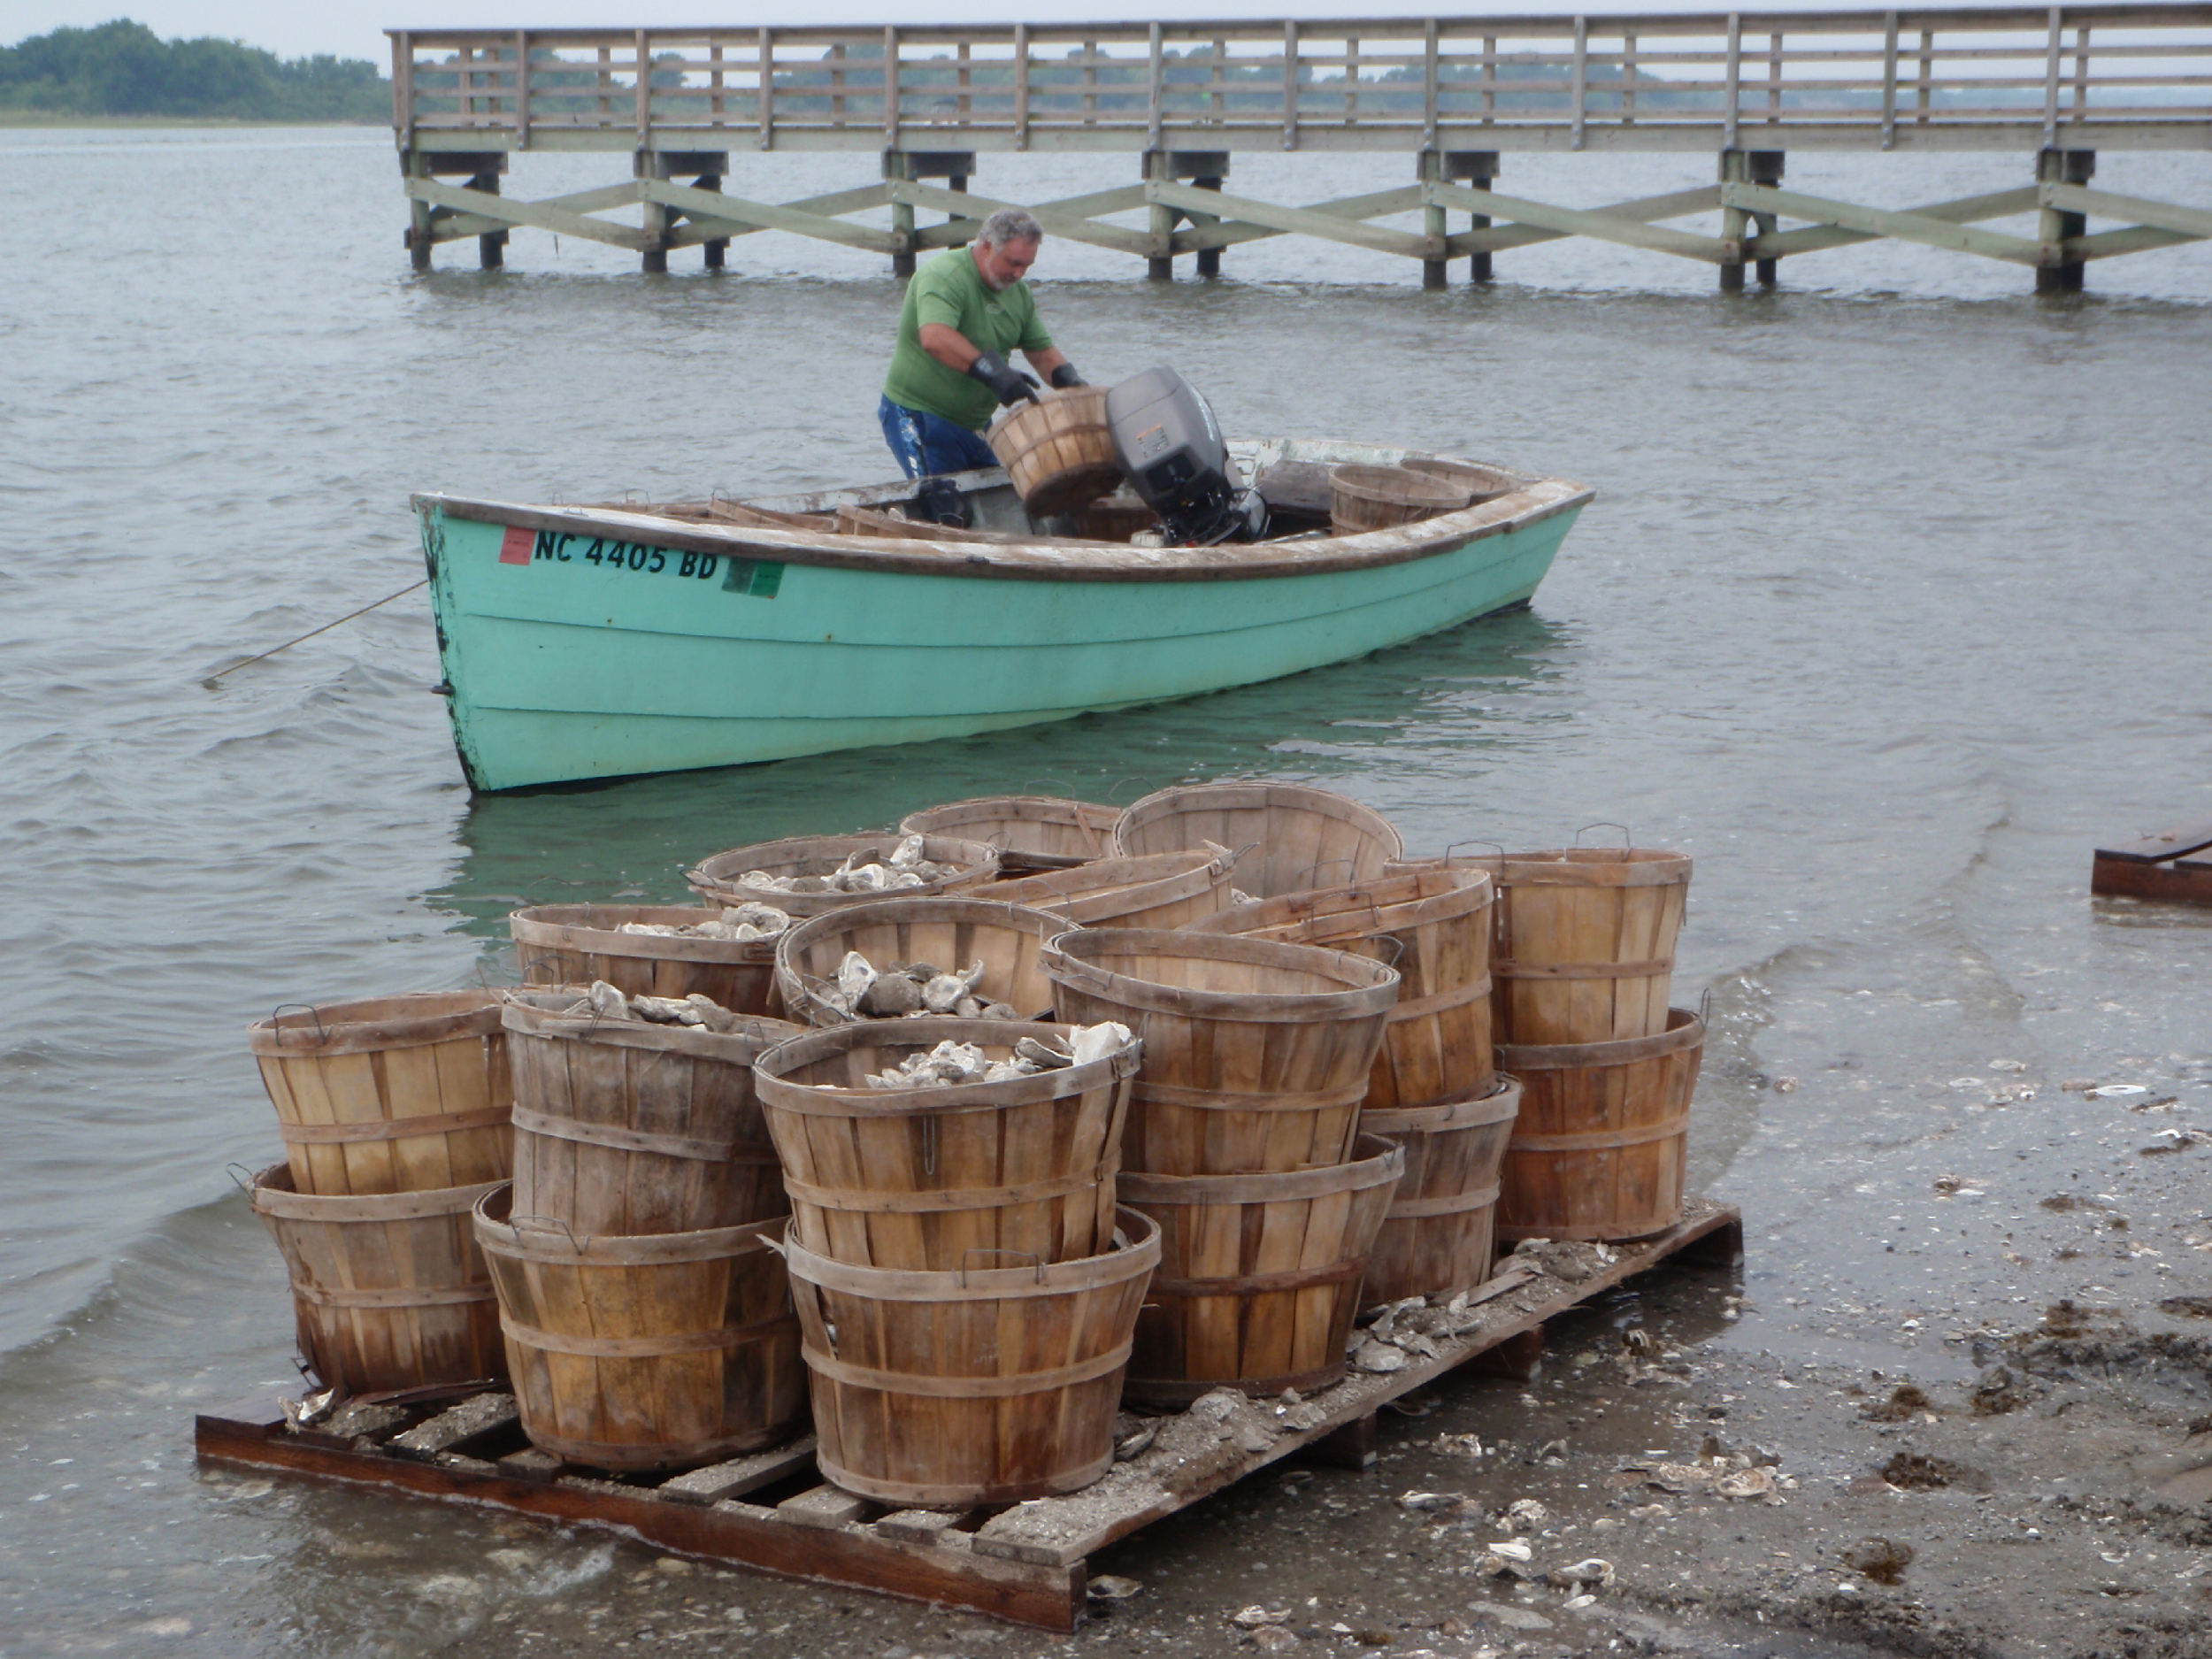
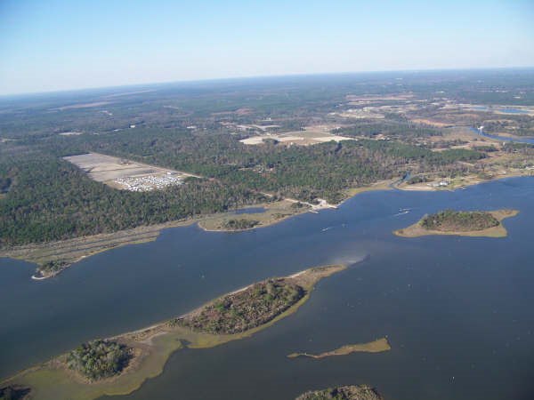
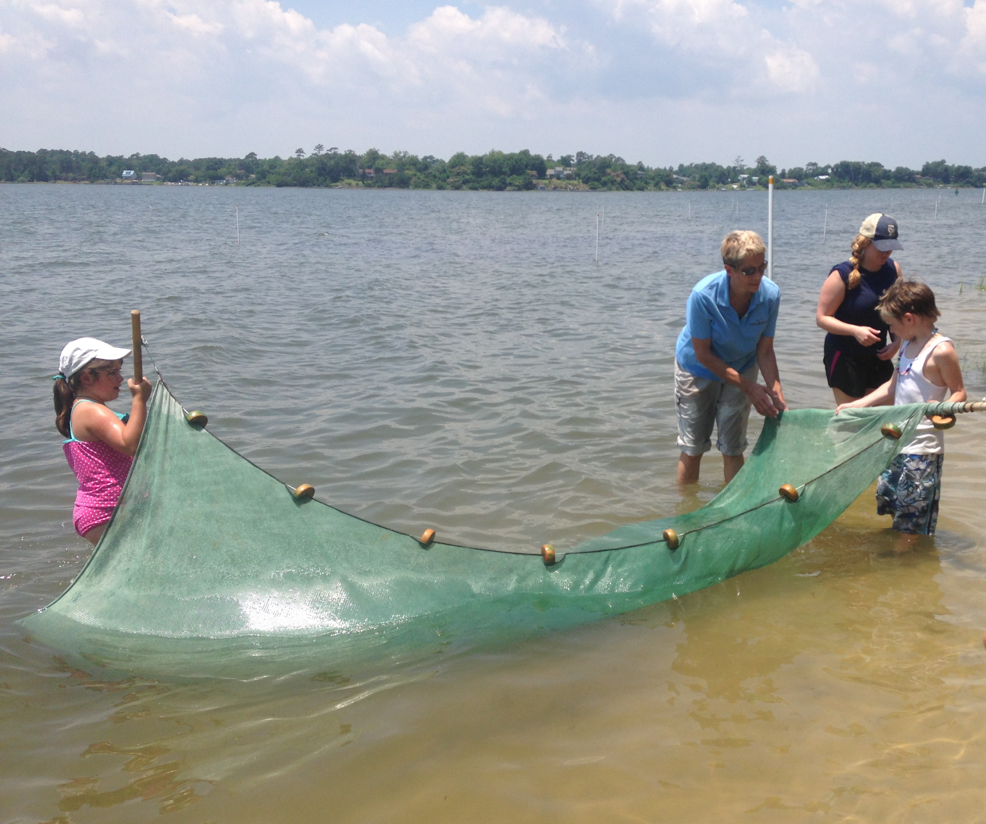
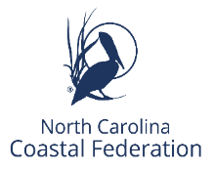
Stump Sound Watershed Protection Planning
This watershed planning effort is made possible through generous funding from the NC Land and Water Fund

Slide 2
The North Carolina Coastal Federation www.nccoast.org
Since 1982, the Coastal Federation has worked to protect and restore the coastal water quality and habitats throughout the N.C. coast.
This is how we do our work:
We Collaborate
From community groups to local businesses to research institutions to government agencies.
We achieve long-lasting results by working together.
We Advocate
We take action by engaging people from all walks of life in decisions about the future of our coast.
Our daily presence in the N.C. General Assembly seeks laws and policies that are in the best interest of the coast and the communities that depend on it.
Notes:
Collaborate: We are known for finding common ground among diverse groups of people, forming unlikely alliances, and recruiting nontraditional partners. We want to work for and with anyone who understands that our well being depends on healthy and productive coastal waters to live, work and play.
Partners: Members, educators, business allies, politicians, students, families,… special interest? Not.
Advocacy We inform and unite people, communities, businesses and government agencies to form effective partnerships.
We build public and therefore political support for compatible land and water uses that protect coastal water quality, critical habitats and public access
By identifying and communicating injustices to both people and the coastal environment, we help decision makers to consider the long-term consequences of their actions- can be collaborative process or sometimes not….. Shining a bright light….
Our contract lobbyist works the legislature moving our agendas forward. We seek laws and policies that are in the best interest of the N.C. coast, and adequate enforcement of these laws and policies.
-Litigation is an important tool that we have and use, but as a last resort. Expensive, occupies limited resources of our organization, must be highest priority needs.

Slide 3
We Restore and Protect
In the field, we restore and protect critically important habitats and water quality.
We Educate
Service learning and community projects
Outdoor and hands-on education using local environmental issues
Create coastal stewards and informed decision-makers.
We Inform
The Coastal Review (CRO), is our award-winning, daily, not-for-profit news and feature service covering the N.C. coast. - A member of the N.C. Press Association.
By building and preserving:
living shorelines
oyster reefs
wetlands
& native coastal forests
3
Notes:
Restore and Protect
In the field, we restore and protect critically important coastal habitats and water quality. How? We engages neighborhoods, local governments, engineers, contractors, landowners, and a host of volunteers to complete both small and very large-scale restoration projects along the N.C. coast.
We install retrofits to drainage systems to reduce the amount of polluted stormwater reaching our waterways, ensuring the waters we all depend on to fish, boat and swim in are clean and safe.
Educate: - - Help make a direct human connection with our natural coast .
. From students building oyster reefs, exploring an inlet shoal, building a community rain garden, or touring a watershed restoration project, to stormwater engineers clamming in Bogue Sound, we help to create a bond between our audience and our coastal habitats, waters and communities.
Inform
The Coastal Federation produces the Coastal Review (CRO) a daily, non-profit, news and feature service covering the NC coast. It is a member of the NC Press Association and works as a public information resource. While the Coastal Federation often advocates for better laws and policies, CRO is not an advocacy publication. Written by professional journalists, CRO’s approach holds strongly to the belief that if you give the public the facts; they will come to the right conclusions.

Slide 4
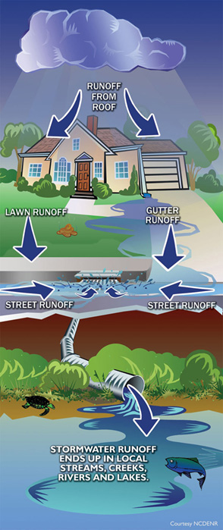
Stormwater Runoff
The No. 1 polluter of our coastal waters (shellfish closures and swimming advisories).
What is it? Rain + Roof + Road = Runoff
Runoff carries bacteria, sediment, freshwater and other pollutants
Occurs when land use alters natural hydrology
Pollution and flooding = expensive problems for property owners, local governments

Slide 5
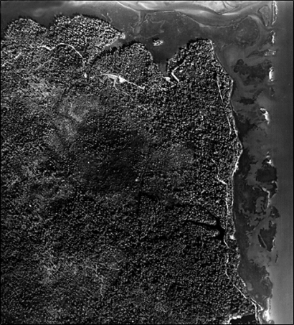
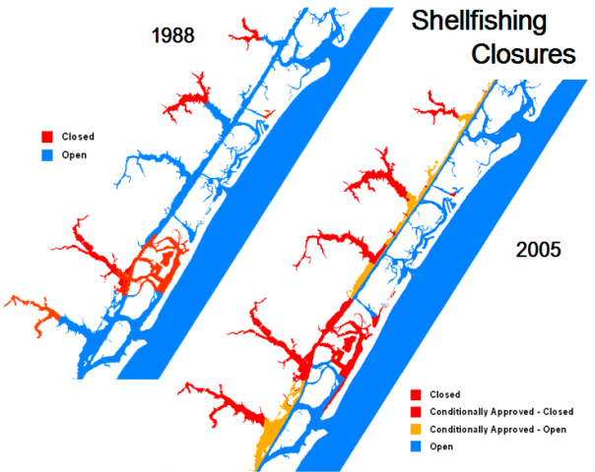
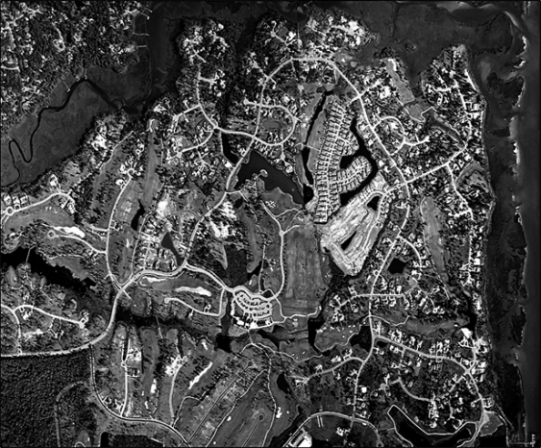
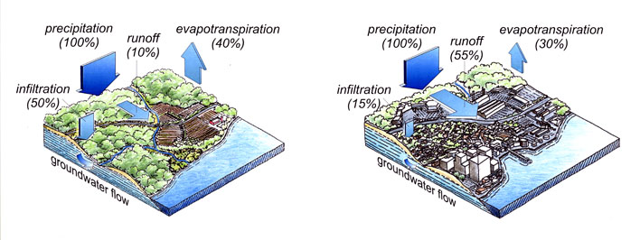
A Changing Coastal Landscape
Howe Creek 1984
Howe Creek 1999

Slide 6
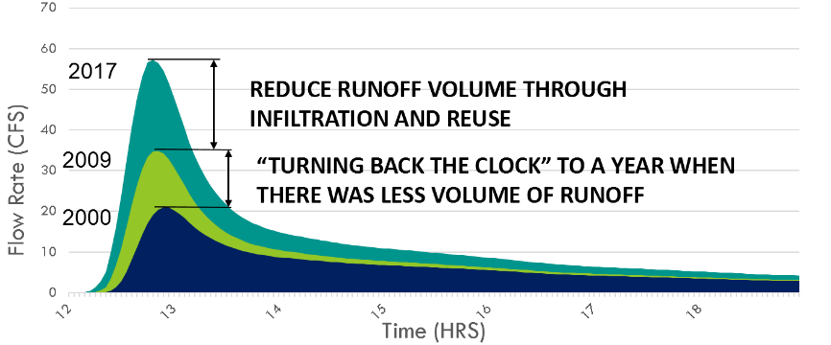
SOLUTION
Reduce the overall volume of stormwater runoff by focusing on the watershed as a whole
Stormwater Hydrograph 2000-2017
Notes:
Conventional methods are ineffective and can be very expensive and often rely on either attempting to treat runoff near the source which results in runoff picking up pollutants again or relies on treating runoff at the end which is often unable to deal with influxes of runoff like during rain events. They also often focus on site by site management.
A novel approach developed by N.C. Coastal Federation relies on focusing on addressing the overall volume of stormwater runoff by focusing on the watershed as a whole through infiltration and reuse of stormwater. In essence turning back the clock to a time when there was less volume of runoff.

Slide 7
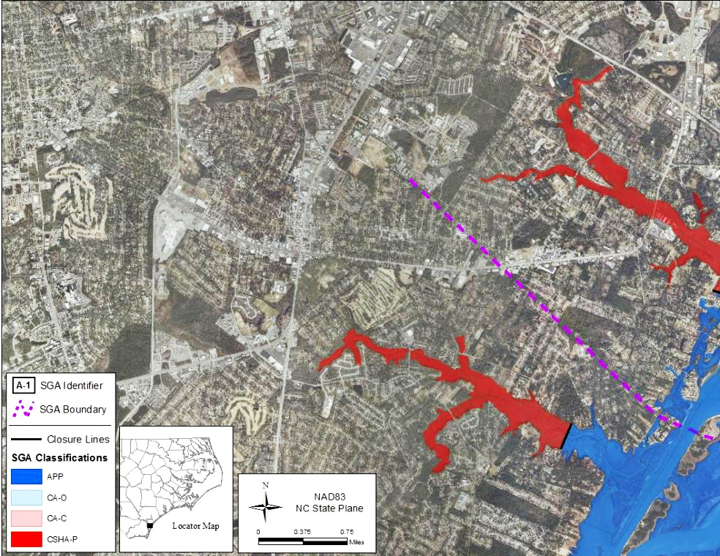
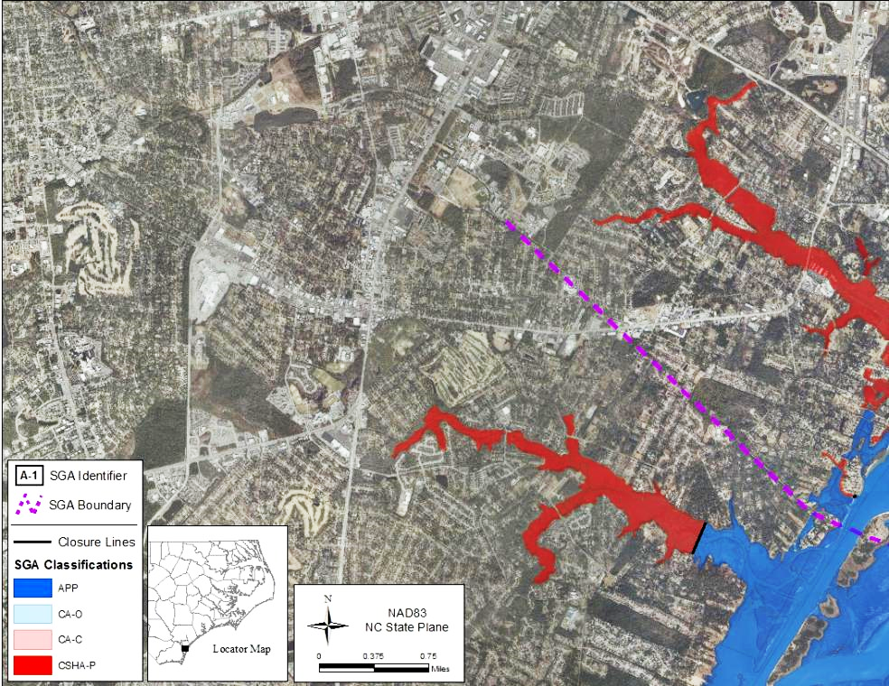
2010
2006
2002
1998
1981
CHANGES IN SHELLFISH CLOSURE BOUNDARIES
1981
2010
Notes:
I like this slide because of the visual teaching of relationship between runoff and increasing of shellfish closures. It also allows a simple explanation of why this creek is more of a “closed system” for the modeling, but the relationship of cause and effect is the same across all urbanized watersheds.
The solution is to reduce the overall volume of stormwater runoff by focusing on the watershed as a whole.

Slide 8
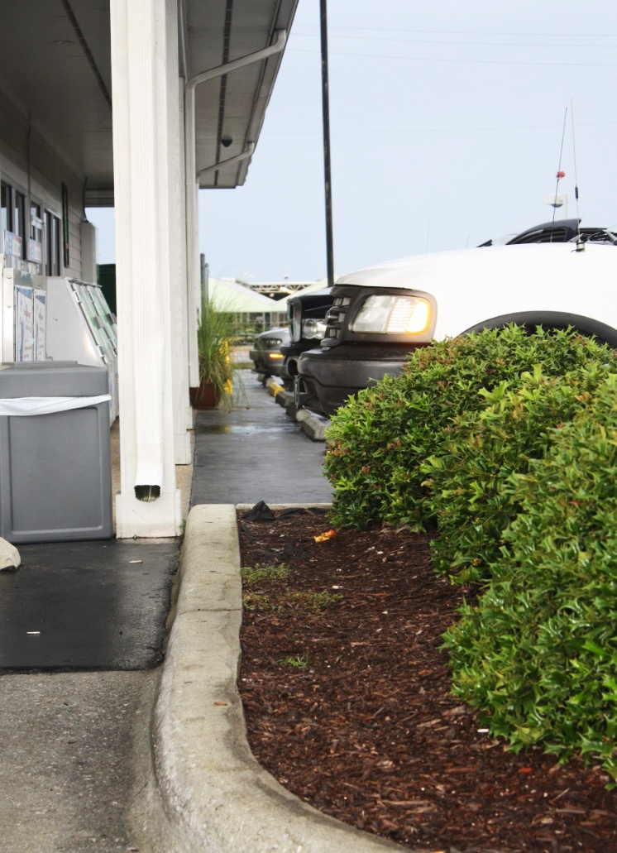
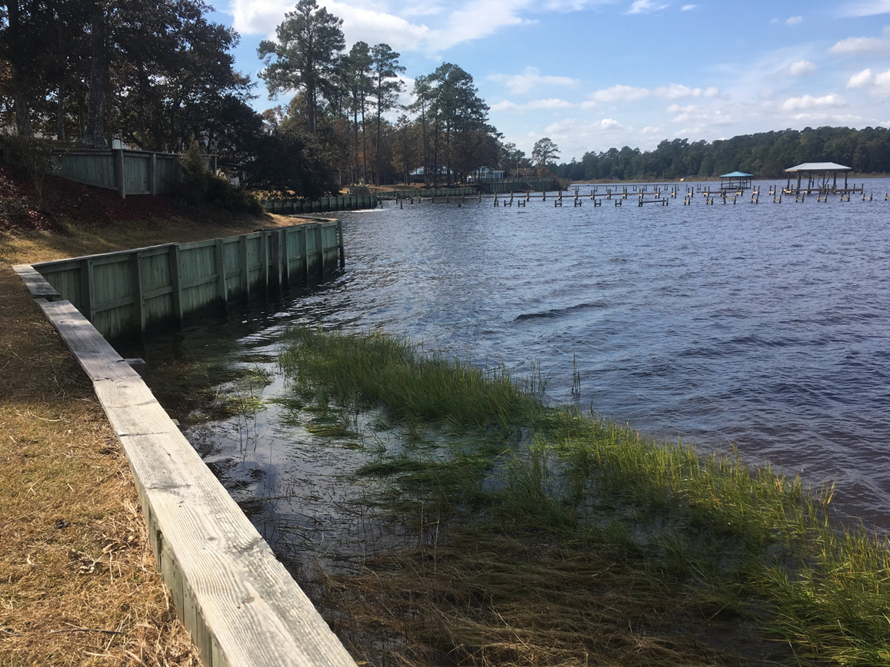
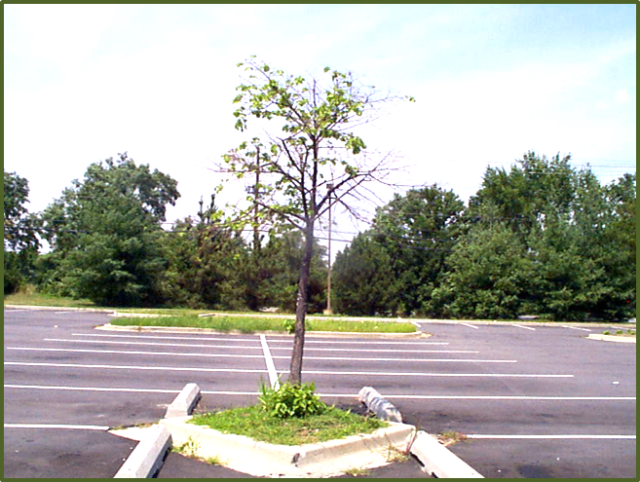
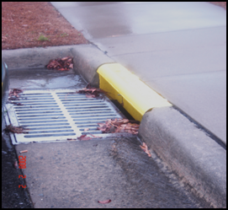
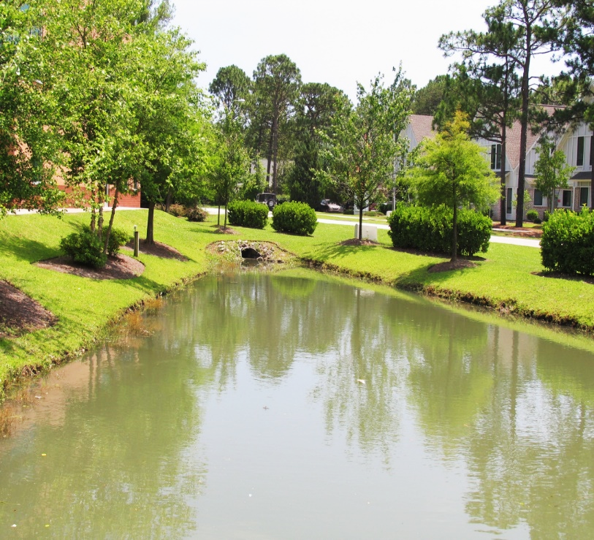
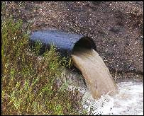
Conventional Watershed Management
Notes:
For decades, our development patterns have collected and conveyed runoff with large scaled, centralized curb and gutter, pipe and pond approach to stormwater management. The goal has been to move water quickly off site. This approach is costly to developers and does not protect water quality.

Slide 9
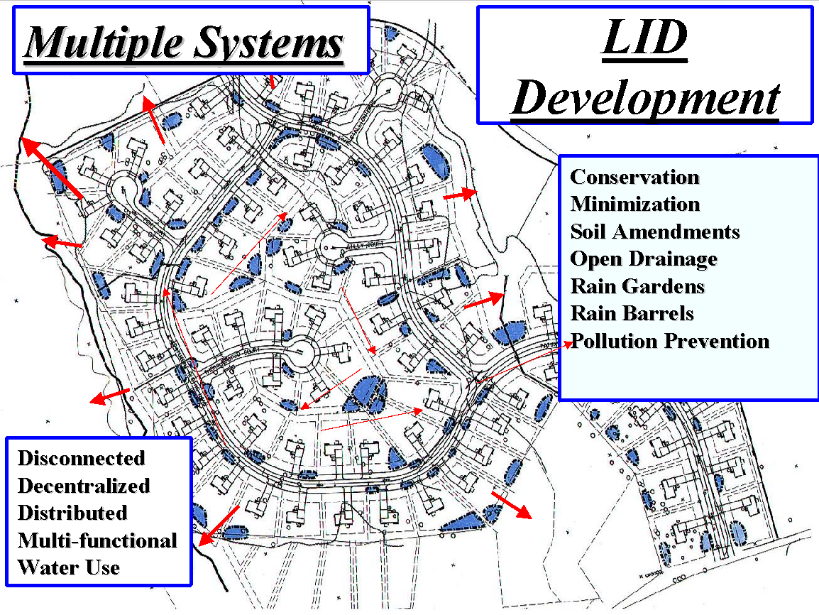
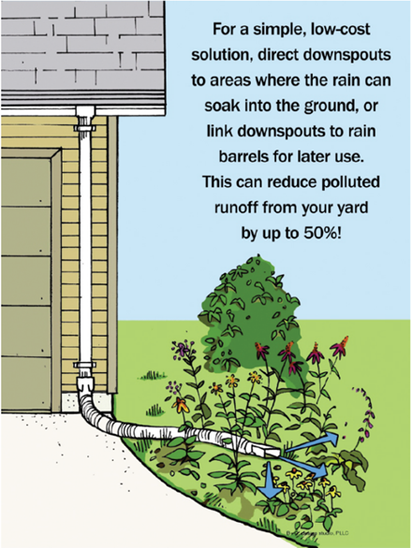
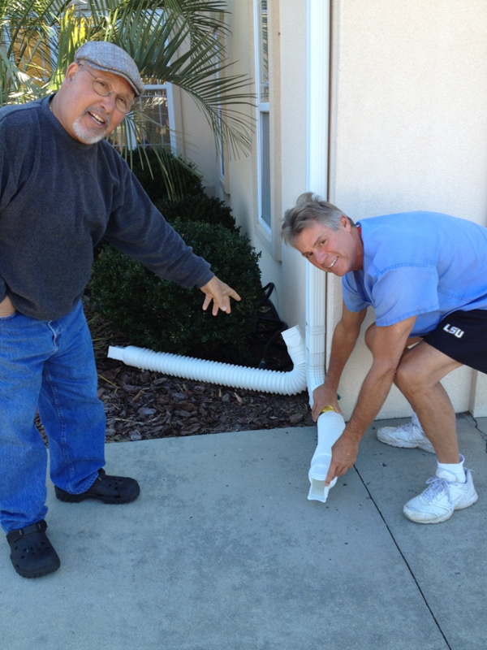
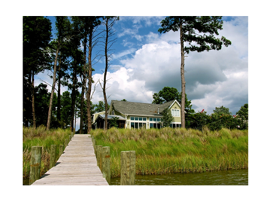
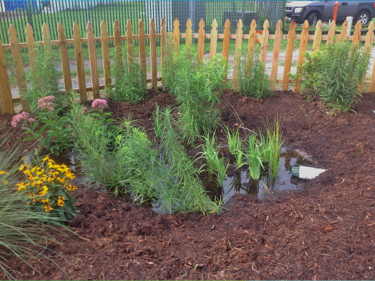
Nature- Based Watershed Management

Slide 10
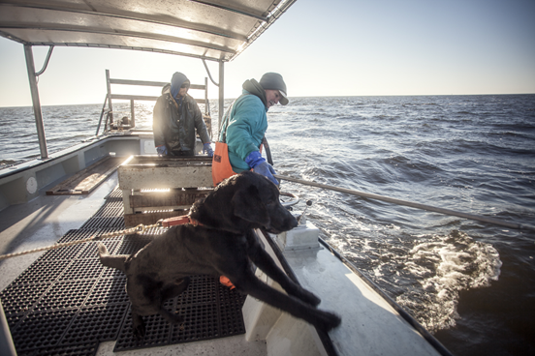
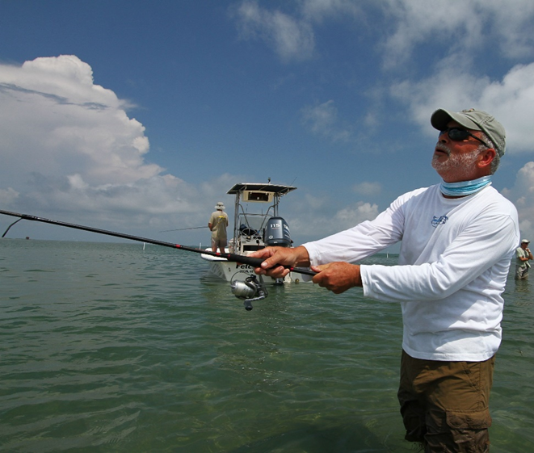
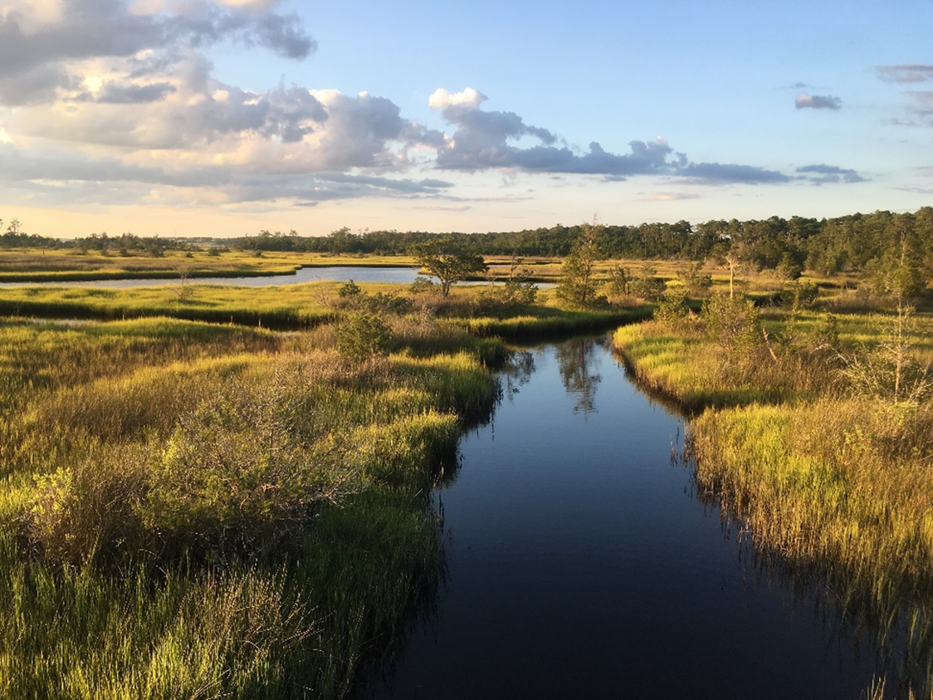
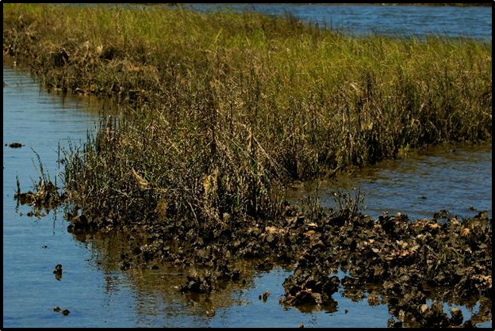
Why Do a Watershed Protection Plan for Stump Sound?
“Turn back the clock” on pollution
Preserve historic uses and culture
Protects property values
Reduce instances of flooding
Align future capital improvements with stormwater retrofits
Increase community awareness and pride
Position counties and towns for funding opportunities

Slide 11
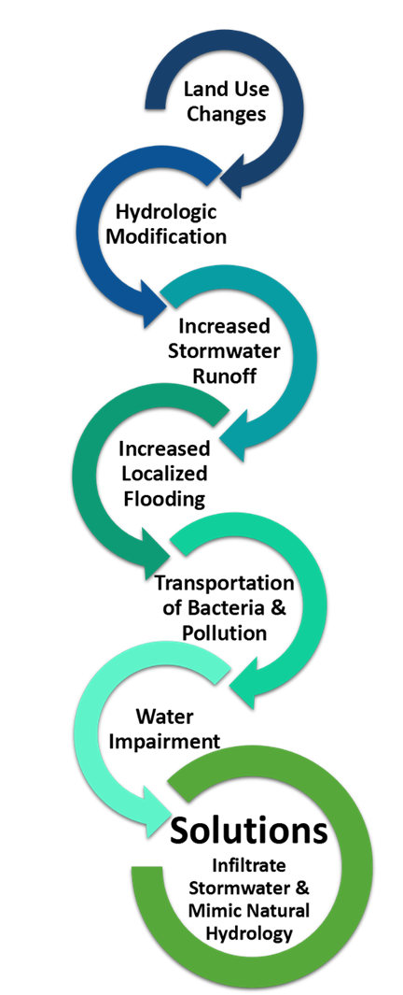
How Can We Better Protect Stump Sound?
Mimic natural hydrology in urban and rural landscapes
Replace conventional stormwater management with nature-based solutions for new/existing land uses
Re-direct/ infiltrate stormwater runoff
Conserve lands
Preserve buffers/conservation easements/open space
Maintain stormwater management measures
Encourage/incentivize/require protective land uses
Encourage existing and historic uses in Stump Sound
Create strong community awareness/ownership/pride

Slide 12
Summary of EPA nine minimum elements
for plan development and inclusion
a. Identify causes and sources of pollution
b. Estimate pollutant loading into the watershed and the expected load reductions
c. Describe management measures that will achieve load reductions and targeted critical areas
d. Estimate amounts of technical and financial assistance and the relevant authorities needed to implement the plan
e. Develop an information/education component
f. Develop a project schedule
g. Describe the interim, measurable milestones
h. Identify indicators to measure progress
i. Develop a monitoring component

Slide 13
First Steps in Planning Process Include
1. Formalize baseline year for data collection
2. Gather necessary data:
watershed characterization, historic land uses, rain fall, historic trends in watersheds and waters, impairments
3. Analyze data, create a watershed inventory
4. Develop a hydrograph:
Calculate the increase in runoff over time and the necessary target volume reductions

Slide 14
Steps for Establishing Stormwater Volume Reduction and Plan Development (2021-2023)
Stakeholder/ Community meetings
Set plan goals and objectives
Develop list of potential retrofit targets and strategies
Create plan including implementation schedule, monitoring and funding needs/ options/ partners

Slide 15
Sign up to receive updates about the Stump Sound Watershed Protection Plan at:
https://www.nccoast.org/protect-the-coast/stormwater/stump-sound-watershed-protection-plan/
Look for special reports from Coastal Review
Register today to receive our daily email of coastal news at: coastalreview.org.
Comments, Questions? tracys@nccoast.org
(910) 509-2838
.
.

