Slide 1
Seismic Testing Surveys
along the Atlantic OCS
Current State of Development
Presented to the League of Women Voters of Dare County
February 27, 2019

Slide 2
Overview
Offshore Seismic Surveys
Seismic Airgun Blasting Impacts
Permit Applications
Permitting Process
Litigation

Slide 3
Offshore Seismic Surveys
Published by the American Petroleum Institute on Feb. 20, 2014
Notes:
The American Petroleum Institute is the largest U.S. trade association for the oil and natural gas industry. It claims to represent about 650 corporations involved in production, refinement, distribution, and many other aspects of the petroleum industry.

Slide 4
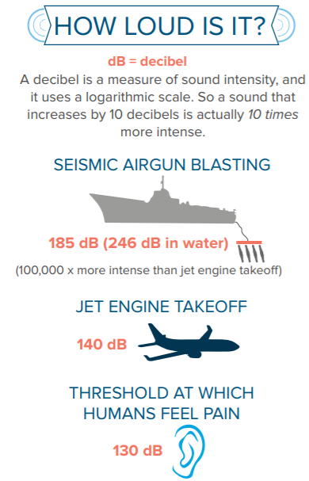

Slide 5
Seismic Airgun Blasting Impacts
Airguns are so loud that they disturb, injure, or kill marine life, harm commercial fisheries, and disrupt coastal economies.
Specific impacts include:
Phytoplankton, zooplankton, bivalve, and fish egg/larvae mortality
McCauley et al,. 2017; Day et al., 2017; Fitzgibbon et al., 2017
Displacement and abandonment of habitat
Paxton et al., 2017, Castellote et al., 2012
Disruption of communication, feeding, and mating
Weilgart, 2013
Temporary and permanent hearing loss
Gordon et al., 2004
Beach stranding and death
Hildebrand, 2005

Slide 6
How Seismic Testing Affects Fish
Published by UNC-TV Science on April 5, 2017
Notes:
“Opportunistic monitoring of a seismic survey offshore of NC during September of 2014 determined whether reef-associated fishes in their natural environment respond to marine seismic surveying. The academic objective of the seismic survey was to study the formation and evolution of the Eastern North American Margin... The majority of the survey occurred in deep (>1000m) waters off the contintental shelf, although it continued across the shelf and into shallow (<35m) inner contintental shelf waters of northeastern Onslwo Bay, NC.” (Paxton et al., 2017)
“Reef-fish abundance declined by 78% during evening hours when fish habitat use was highest on the previous three days without seismic noise.” (Paxton et al., 2017)

Slide 7
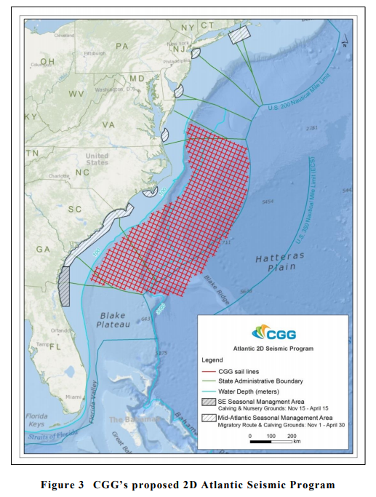
CGG proposed a survey that consists of 53 lines from GA to VA totaling 17,815 mi and would travel an average speed of 4.5 kn in water depths that range from 100 m to over 4,000 m.
Notes:
A single seismic research vessel, operating 24 hours a day, will travel along the survey lines to acquire seismic data. The line lengths for the proposed survey area by CGG is 186 mi to 466 mi in length and will take approximately 36 to 90 hours to complete. Upon reaching the survey line, the vessel will take four to six hours to turn around and start another line. The seismic acoustic source will be silent during line changes.

Slide 8
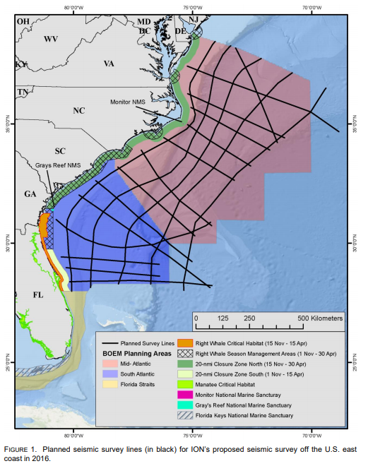
ION GeoVentures proposed a survey that consists of 19 lines from FL to DE totaling 8,116 mi and would travel an average speed of 4 kn in water depths that range from less than 100 m to over 3,000 m.
Notes:
ION GeoVentures

Slide 9
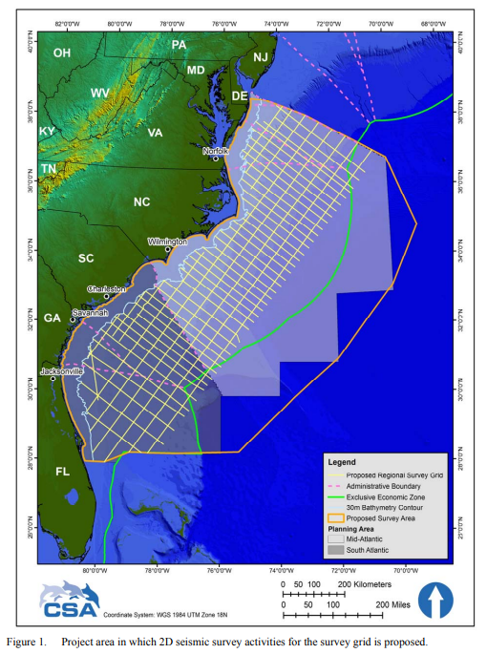
Sepctrum Geo Inc. proposed a survey that consists of 53 lines from FL to DE totaling 13,380 mi and would travel an average speed of 4.5 kn in water depths that range from less than 100 m to over 5,000 m.
Notes:
Spectrum Geo Inc.

Slide 10
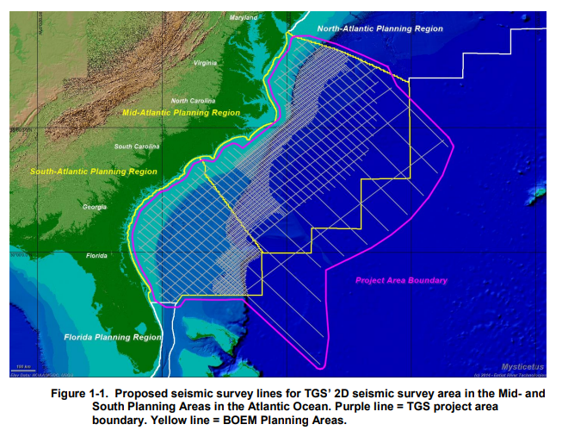
TGS-NOPEC Geophysical Company proposed a survey that consists of 227 lines from FL to DE totaling 34,258 mi and would travel an average speed of 4.5 kn in water depths that range from less than 100 m to over 5,000 m.
Notes:
TGS-NOPEC Geophysical Company

Slide 11
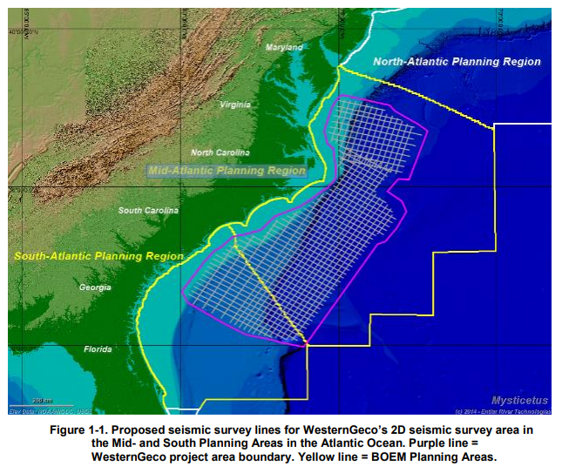
WesternGeco, LCC proposed a survey that consists of 84 lines from SC to DE totaling 17,595 mi and would travel an average speed of 4.5 kn in water depths that range from less than 100 m to over 4,000m.
Notes:
WesternGeco, LLC

Slide 12
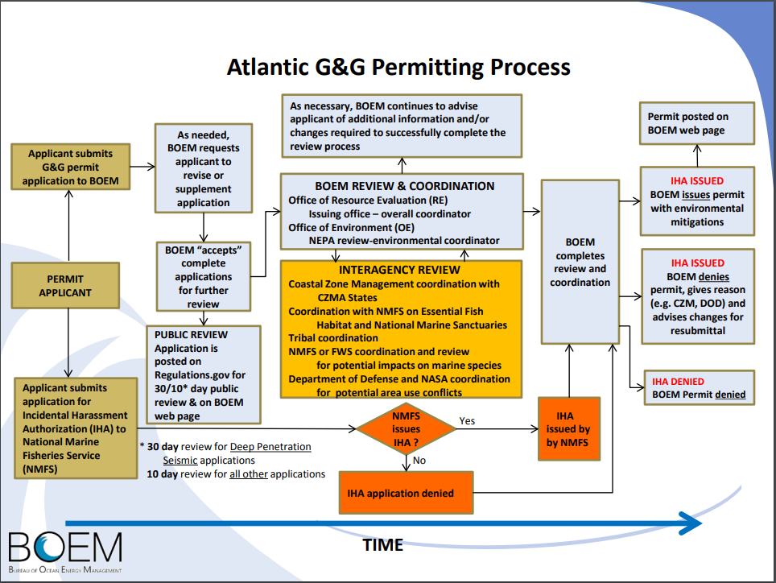
Geological & Geophysical
Notes:
Decision to issue IHAs to 5 companies that submitted applications occurred in November 2018.

Slide 13
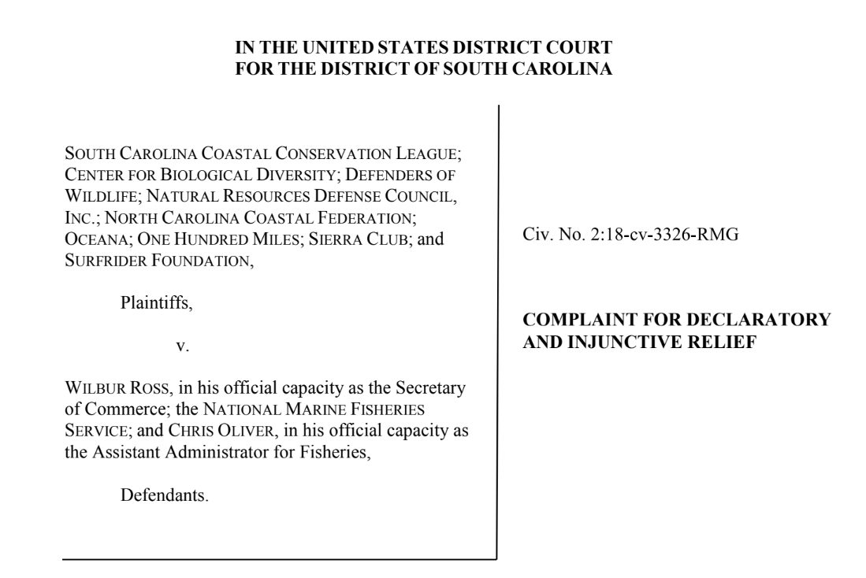
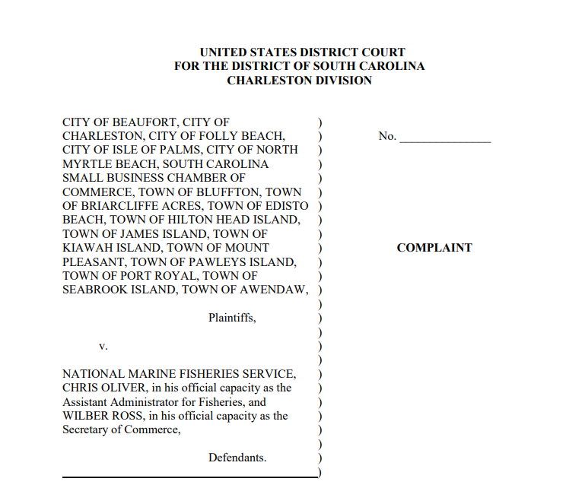
If permitted, seismic airgun blasts would occur every 10-60 seconds while 5 different companies survey simultaneously for months.
Notes:
Lawsuit filed on December 11, 2018

Slide 14
Decision to issue IHAs Legally Challenged
December 2018
9 environmental organizations challenged the decision claiming it violates:
Marine Mammal Protection Act
Endangered Species Act
National Environmental Policy Act
Plaintiffs represented by the Southern Environmental Law Center and Earth Justice
16 S.C. municipalities and small business organizations filed a separate case
Plaintiffs represented by the S.C. Environmental Law Project
The separate cases have been consolidated
Attorneys General along Atlantic coast and a coalition of public aquariums join plaintiff
American Petroleum Institute and International Association of Geophysical Contractors join defendant
February 2019
A motion for a preliminary injunction filed by plaintiff to block seismic testing activity from occurring until legal challenge is resolved.

Slide 15
2019-2024 National OCS
Oil and Gas Leasing Program
Current State of Development
Presented to the League of Women Voters of Dare County
February 27, 2019

Slide 16
Outline
Background:
National OCS Oil and Gas Leasing Program
U.S. Department of the Interior (DOI)
Bureau of Ocean Energy Management (BOEM)
Outer Continental Shelf (OCS)
2017-2022 National Program
BOEM 2019-2024 Draft Proposed Program (DPP)
Don’t Drill NC Coalition
Rally to Raleigh
Legislative Activity
What’s Next?
Take Action

Slide 17
National OCS Oil and Gas Leasing Program
The Bureau of Ocean Energy Management (BOEM) develops the Outer Continental Shelf Oil and Gas Leasing Program (National OCS Program) for oil and gas development in accordance with the Outer Continental Shelf Lands Act (OCS Lands Act).

Slide 18
National OCS Oil and Gas Leasing Program
This National OCS Program establishes a five-year schedule of oil and gas lease sales proposed for the U.S. OCS.
The National OCS Program specifies the size, timing, and location of potential leasing activity that the Secretary of the Interior determines will best meet national energy needs for the five-year period under consideration.

Slide 19
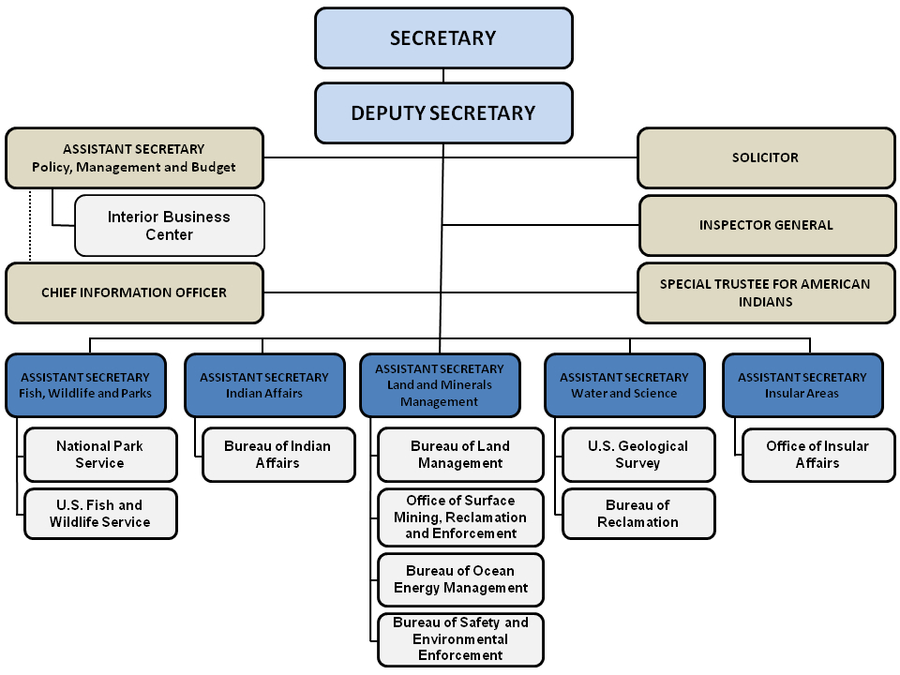
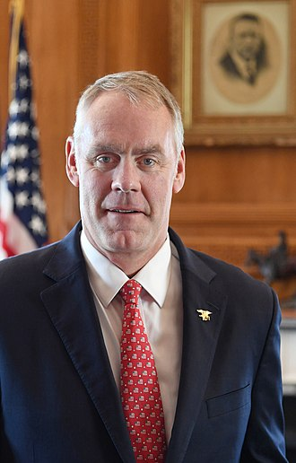
U.S. Department of the Interior
Former Secretary
Ryan Zinke
(March 2017 – December 2018)
Notes:
The Department of the Interior is the federal executive department of the U.S. government responsible for the management and conservation of federal lands and natural resources.

Slide 20
U.S. Department of the Interior
Acting Secretary
David Bernhardt
(January 2019 - Present)
Notes:
The Department of the Interior is the federal executive department of the U.S. government responsible for the management and conservation of federal lands and natural resources.

Slide 21
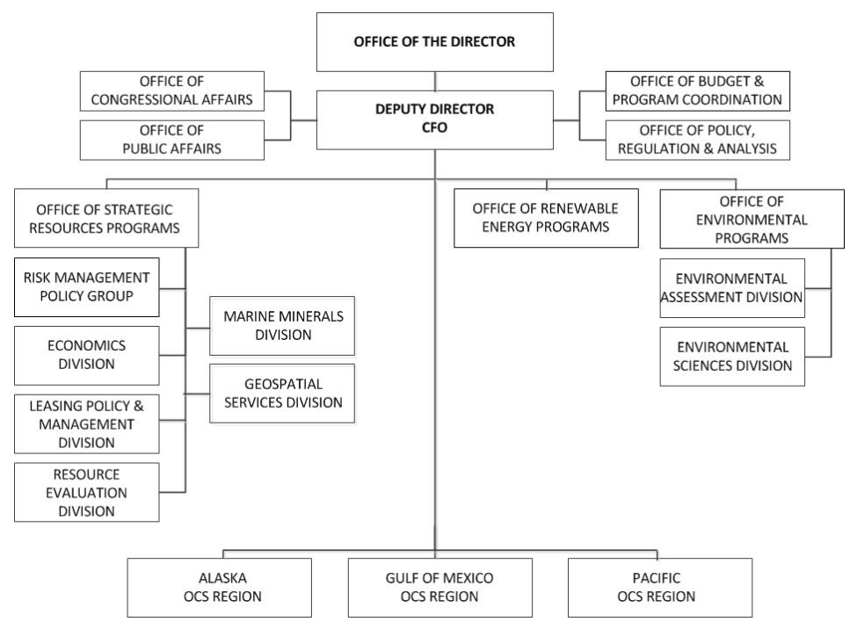
Bureau of Ocean Energy Management
Acting Director
Walter Cruickshank
(January 2017 - Present)
Notes:
The BOEM Office of Strategic Resources is responsible for the development of the Five Year Outer Continental Shelf (OCS) Oil and Natural Gas Leasing Program.

Slide 22
Bureau of Ocean Energy Management
(BOEM)
An operating unit of the Department of the Interior (DOI)
Formerly the Minerals Management Service (MMS)
In June 2010 MMS was renamed:
Bureau of Ocean Energy Management, Regulation, and Enforcement (BOEMRE)
Revenue collection handled by DOI’s Office of Policy, Management, and Budget
In October 2011, BOEMRE was reorganized into:
Bureau of Ocean Energy Management (BOEM)
Bureau of Safety and Environmental Enforcement (BSEE)
Purpose:
Separate resource management from safety oversight
Provide a structure that ensures that robust environmental analyses are conducted
Strengthens the role of environmental review and analysis in both organizations
Notes:
Evolution of BOEM

Slide 23
Bureau of Ocean Energy Management
(BOEM)
The mission of BOEM is to manage development of U.S. Outer Continental Shelf energy and mineral resources in an environmentally and economically responsible way.
The bureau promotes energy independence, environmental protection, and economic development through responsible management of offshore resources based on the best available science.
The BOEM Office of Strategic Resources is responsible for the development of the Five Year Outer Continental Shelf (OCS) Oil and Natural Gas Leasing Program.
Oversees assessments of the oil, gas, and other mineral potential of the OCS, inventories oil and gas reserves, develops production projections, conducts economic evaluations to ensure fair market value is received by the U.S. taxpayers for OCS leases, and prepares official maps and GIS data for the OCS.

Slide 24
Outer Continental Shelf
(OCS)
Federal Jurisdiction is defined under accepted principles of international law. The seaward limit is defined as the farthest of 200 nautical miles seaward of the baseline from which the breadth of the territorial sea is measured or, if the continental shelf can be shown to exceed 200 nautical miles, a distance not greater than a line 100 nautical miles from the 2,500-meter isobath or a line 350 nautical miles from the baseline.
State Jurisdiction:
Texas and the Gulf coast of Florida are extended 3 marine leagues (9 nautical miles) seaward from the baseline from which the breadth of the territorial sea is measured.
Louisiana is extended 3 U.S. nautical miles seaward of the baseline from which the breadth of the territorial sea is measured.
All other States’ seaward limits are extended 3 International Nautical Miles seaward of the baseline from which the breadth of the territorial sea is measured.
Notes:
The seaward limit of the outer continental shelf (OCS) extends for 200 nautical miles from where the baseline of the territorial sea is measured, which is variable depending on the state of reference. In North Carolina, the seaward limits of state jurisdiction extend for 3 international nautical miles
English mile = 5,280 feet
U.S. nautical mile = 6,080.2 feet
International nautical mile = 6,076.1033 feet.

Slide 25
Oil and Gas Revenue Sharing
Section 8(g) of the Outer Continental Shelf Lands Act of 1953
addresses leasing details for “lands containing tracts wholly or partially within three nautical miles of the seaward boundary of any coastal State,” that is, the first three nautical miles of federal waters which border on state waters and, in most cases, are within several miles of the state’s shoreline. Under the terms of Section 8(g), all revenue from leases wholly within that three-nautical-mile range must be deposited in a dedicated account in the Treasury. For leases partially within the three nautical mile range of state waters, a corresponding portion of the revenue from the lease must be deposited in the special account. The Secretary then must transfer to the coastal state 27% of the revenues collected from leases near their coastal waters. If the tract in question lies only partly within the first three nautical miles of federal waters, the disbursement to the coastal state is adjusted based on the percentage of the tract that lies within those three nautical miles. OCSLA also establishes a procedure for the resolution of boundary disputes.
Source: Vann. A. 2018 Offshore Oil and Gas Development Legal Framework. Congressional Research Service. https://fas.org/sgp/crs/misc/RL33404.pdf

Slide 26
Oil and Gas Revenue Sharing
Gulf of Mexico Energy Security Act (GOMESA) of 2006
This Act created revenue sharing provisions for the four Gulf oil and gas producing States of Alabama, Louisiana, Mississippi, and Texas.
Phase I: Began in Fiscal Year 2007 and allocated 37.5% of qualified revenues are shared among the four states from new leases issued within the planning area and 12.5% of revenues are allocated to the Land and Water Conservation Fund
Phase II: Began in Fiscal Year 2017 and expanded the definition of qualified OCS revenues from GOM leases issued after December 20, 2006 and placed a revenue sharing cap of $500 million per year from fiscal years 2016 through 2055. The $500 million cap does not apply to Phase I..
Source: Bureau of Ocean Energy Management. Gulf of Mexico Energy Security Act (GOMESA). https://www.boem.gov/Revenue-Sharing/

Slide 27
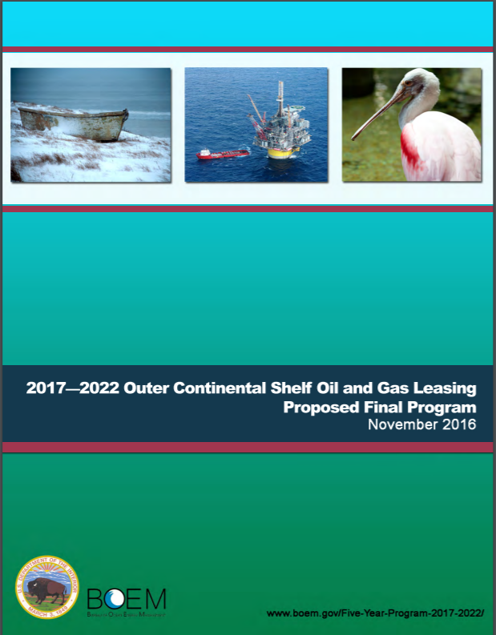
2017-2022 National OCS
Oil and Gas Leasing Program
Section 18 of the Outer Continental Shelf Lands Act (OCSLA) requires the Secretary of the Interior to prepare and maintain a schedule of proposed Outer Continental Shelf (OCS) oil and gas lease sales determined to best meet national needs for the five years following approval of the schedule. Otherwise known as the National OCS Program. BOEM is currently working under the approved 2017 – 2022 Program.
Notes:
https://www.boem.gov/National-OCS-Program-for-2017-2022/

Slide 28
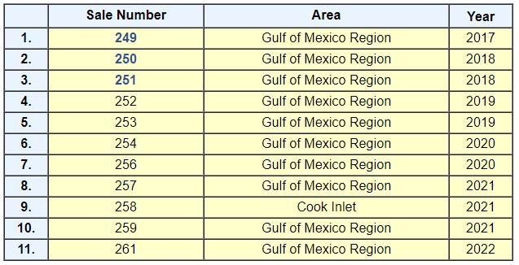
2017-2022 Lease Sale Schedule
March 20, 2019
Notes:
29 companies participated in the lease sale no. 251 bid process on August 15, 2018.

Slide 29
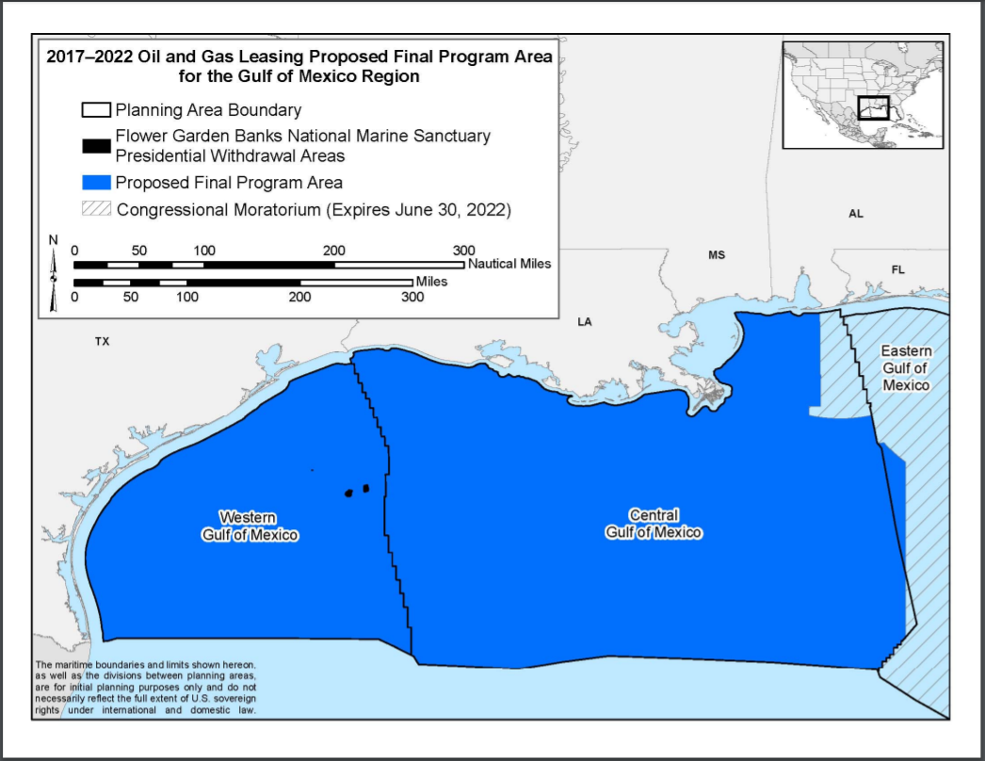
Notes:
29 companies participated in the lease sale no. 251 bid process on August 15, 2018.

Slide 30
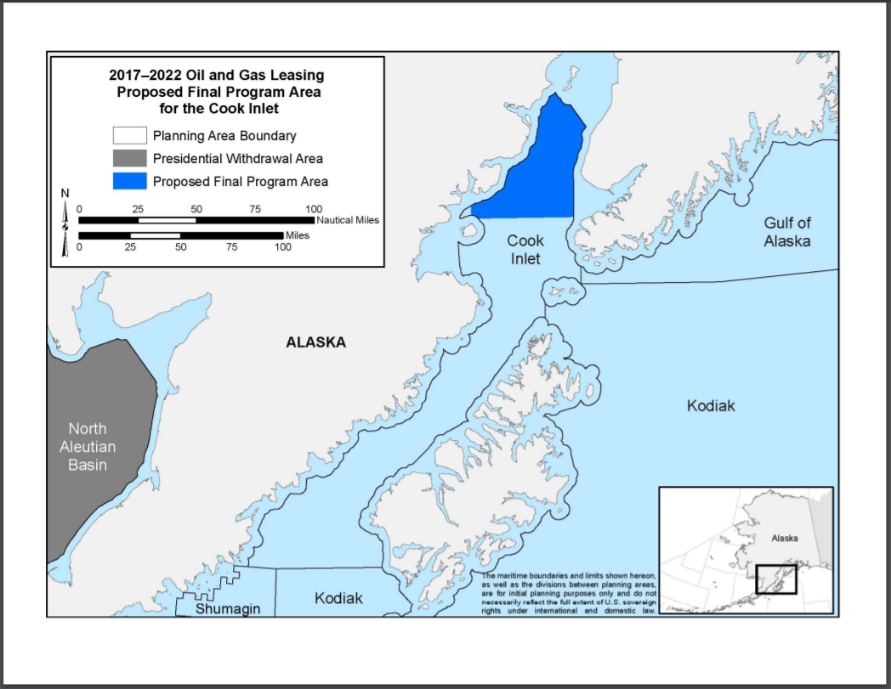

Slide 31
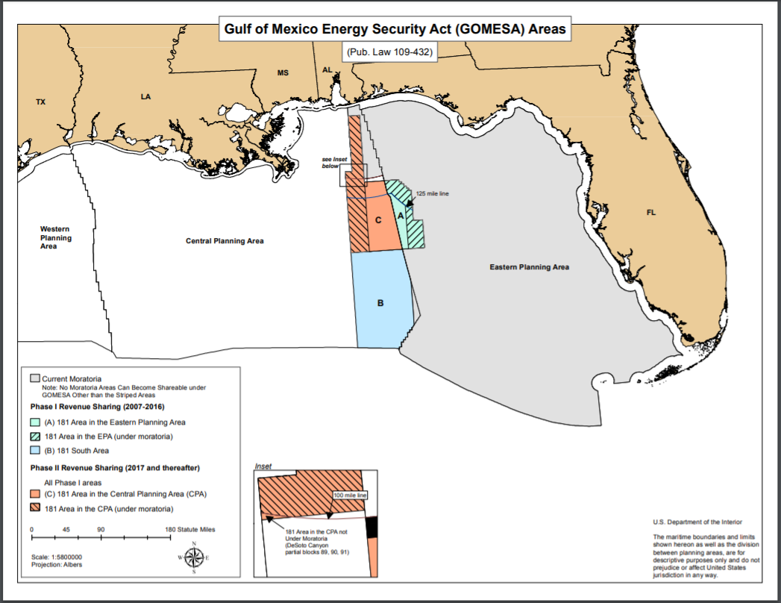
Notes:
https://www.boem.gov/Areas-Under-Moratoria/

Slide 32
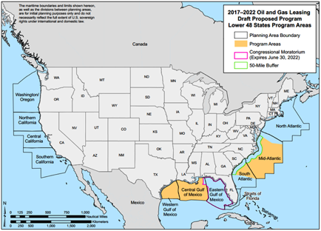
Notes:
The Mid-Atlantic and South-Atlantic regions were included in the 2017-2022 Draft Proposed Program, however, they were removed following the direct, indirect, and cumulative impacts of oil and gas activities described in the Final Environmental Impact Statement (EIS) released on March 15, 2016.

Slide 33
Developing a New National OCS Program
Executive Order 13795 (April 28, 2017)
and
Secretary’s Order 3350 (May 1, 2017)
directed BOEM to initiate a process to develop a new National OCS Program for 2019-2024 that, if approved, will supersede the 2017-2022 Program.

Slide 34
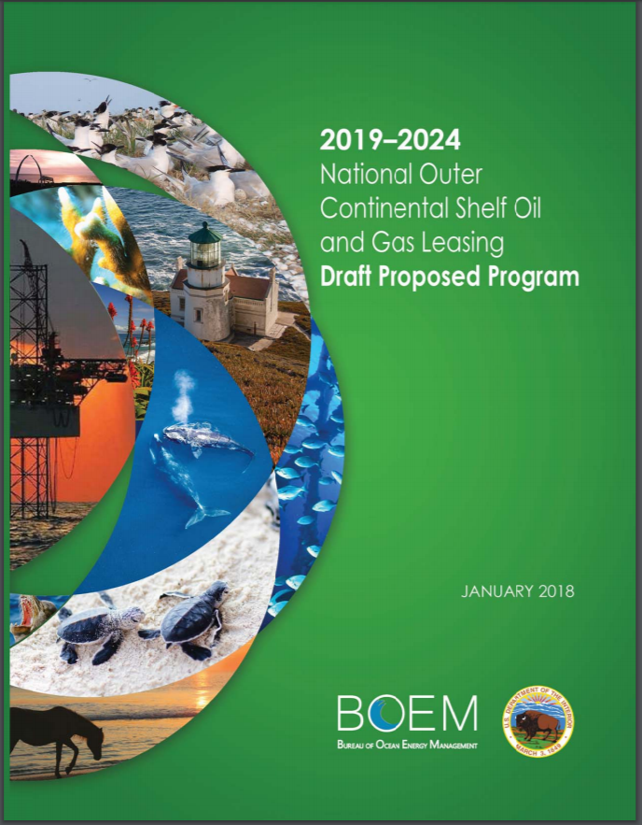
2019-2024 Draft Proposed National OCS
Oil and Gas Leasing Program
Request for Information published in Federal Register on July 3, 2017
Initiated 45-day comment period
Closed August 17, 2017
Draft Proposed Program released on January 4, 2018,
Initiated 60-day comment period
Closed March 9, 2018.
Comments can be viewed online at Regulations.gov
1,670,314 comments received by close
2,058,752 comments submitted to date
Notes:
https://www.boem.gov/National-OCS-Program-for-2017-2022/

Slide 35
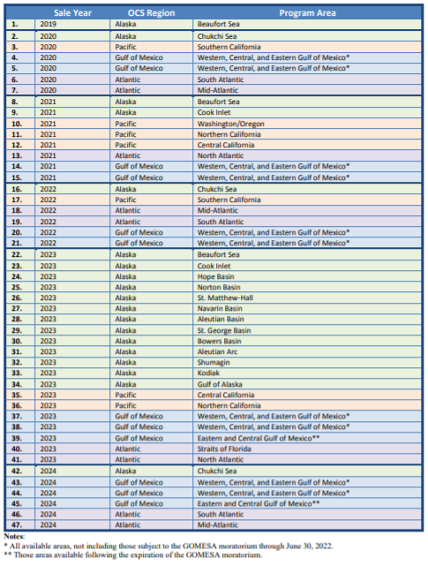
2019-2024
Draft Proposed Program
Lease Sale Schedule
Notes:
2019-2024 Draft Proposed Program Lease Sale Schedule contains 47 total lease sales and 3 in the Mid-Atlantic. The first would occur at the end of 2020, then 2022, and finally in 2024.

Slide 36
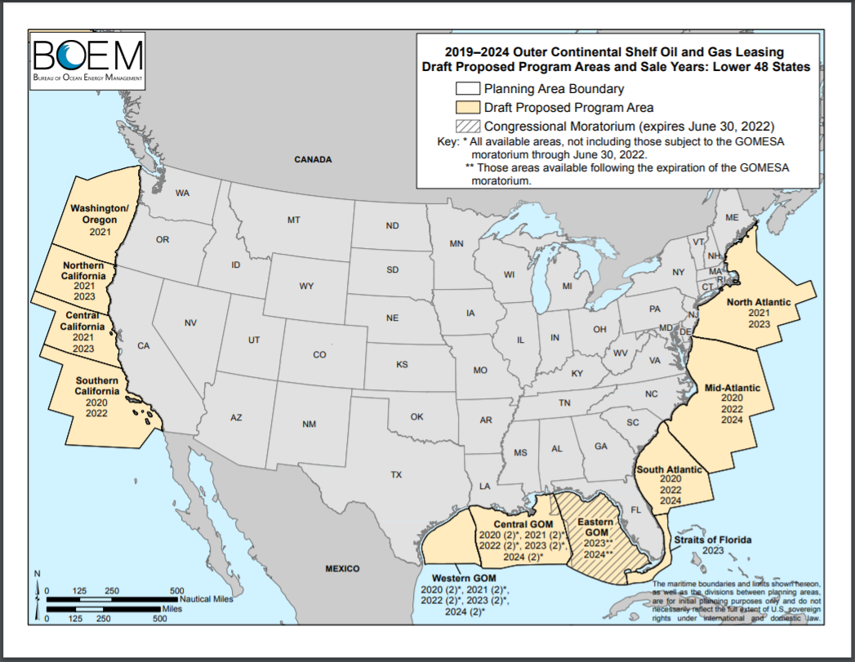
Notes:
2019-2024 Draft Proposed Program Lease Sale Schedule contains 47 total lease sales and 3 in the Mid-Atlantic. The first would occur at the end of 2020, then 2022, and finally in 2024.

Slide 37
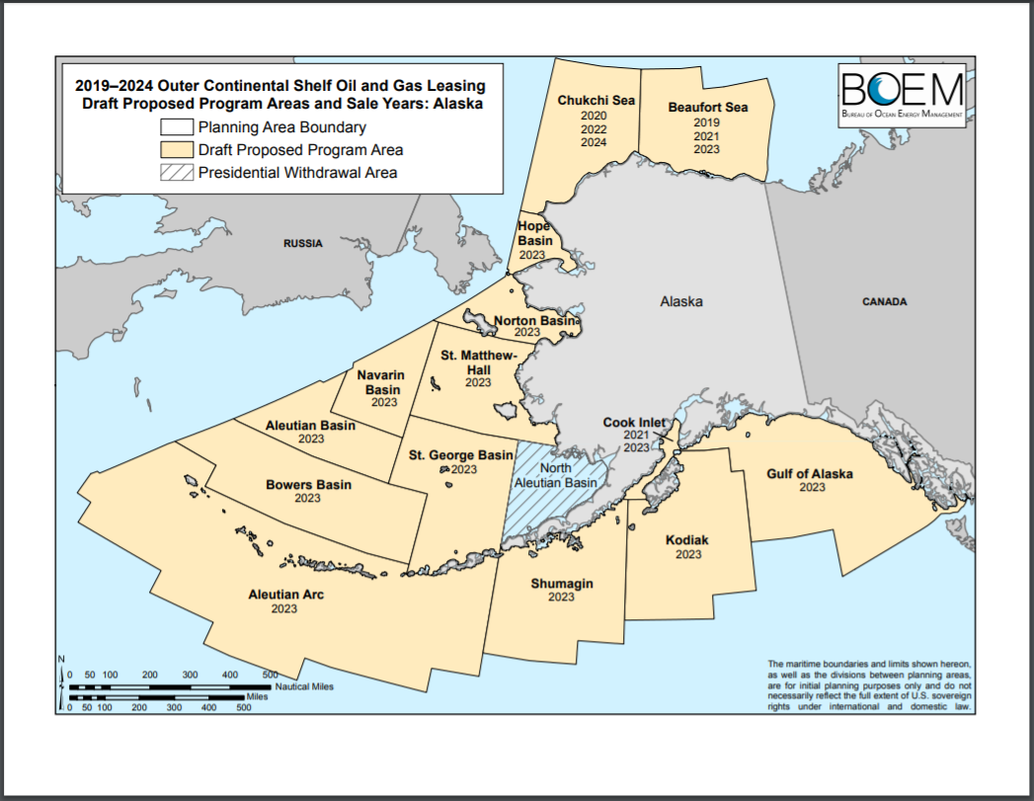
Notes:
2019-2024 Draft Proposed Program Lease Sale Schedule also contains lease sales in Alaska.

Slide 38
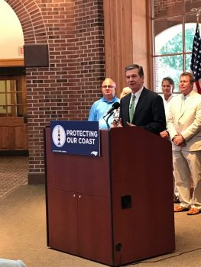
“Not off our coast!” – Governor Cooper
Governor Cooper announced his opposition to offshore oil drilling and seismic blasting at Fort Macon State Park in Atlantic Beach on June 29, 2017.
Released a statement on January 4, 2018 reiterating opposition following the release of the Draft Proposed Program
NC Attorney General Josh Stein assembled a coalition of attorneys general from 11 other coastal states.
NCDEQ submitted arguments against offshore drilling and seismic blasting.

Slide 39
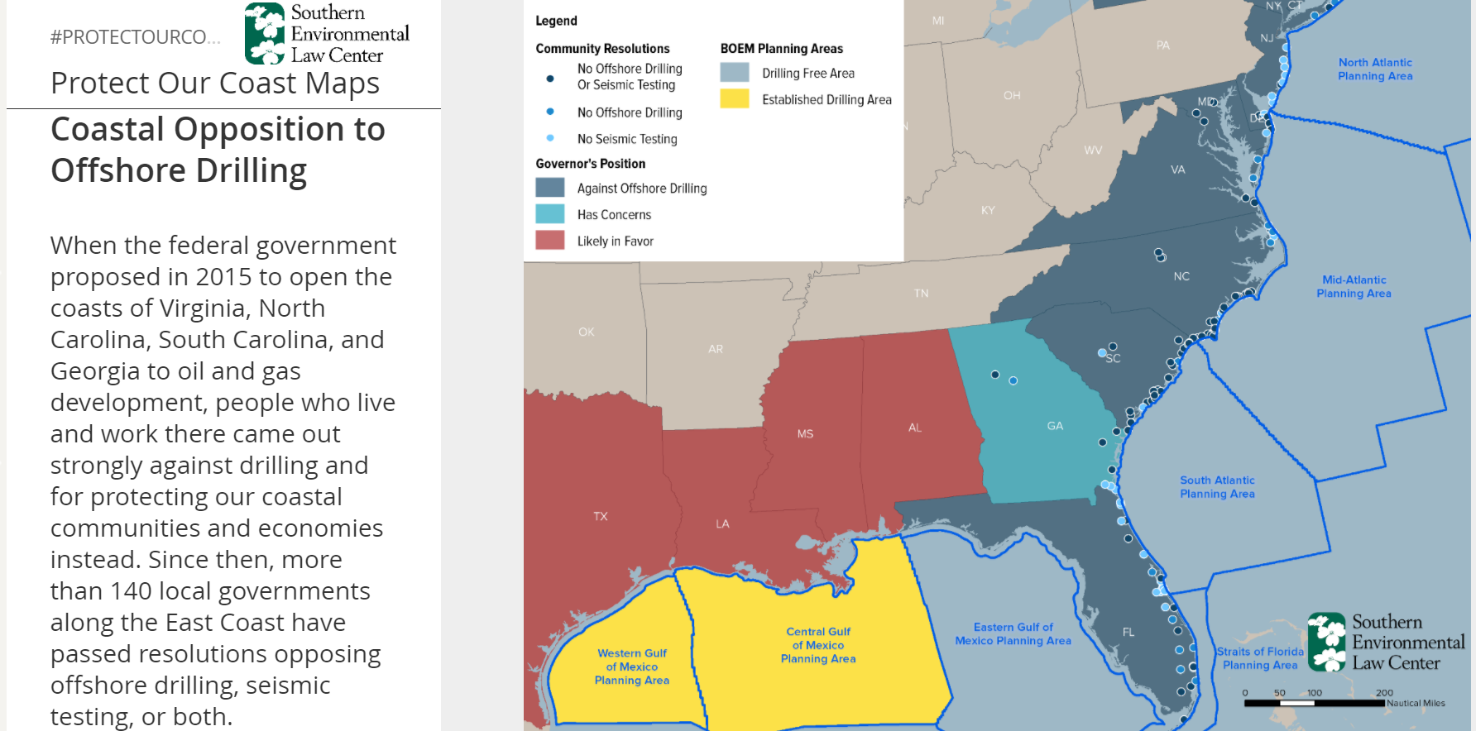

Slide 40
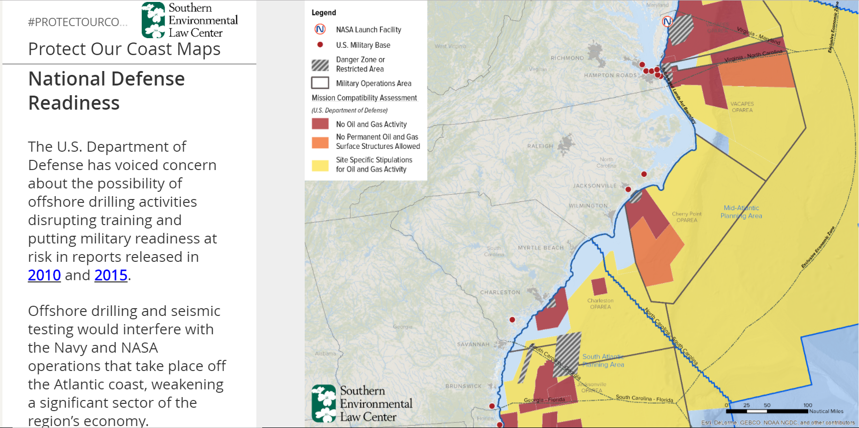

Slide 41
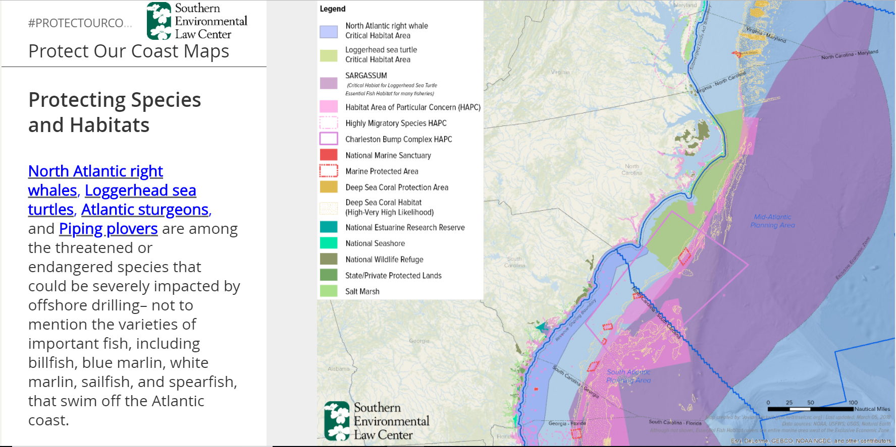

Slide 42
Don’t Drill NC Coalition
A coalition of organizations opposed to offshore oil and gas exploration as well as seismic air gun blasting.
Publish fact sheets
Host film screenings
Facilitate meetings with stakeholders and elected officials
Encourage passage of resolutions
Submit comments
Organized the Rally to Raleigh
dontdrillnc.org

Slide 43
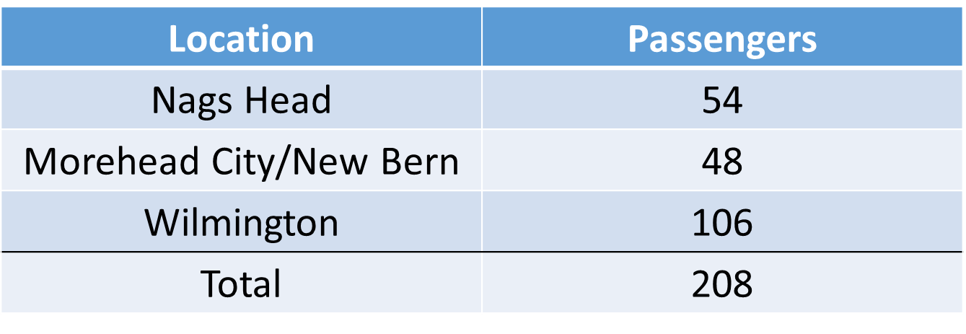
Rally to Raleigh Bus Trip to attend BOEM Open House on February 26, 2018
Local leadership included:
Ben Cahoon, Mayor (Nags Head); Susie Walters, Mayor Pro Tem (Nags Head); Terry Gray, Commissioner (Kill Devil Hills) John Windley, Commissioner (Kill Devil Hills); Monica Thibodeau, Mayor Pro Tem (Duck); Matt Walker (Surfrider Outer Banks Chapter)

Slide 44
Rally to Raleigh: Press Event
State Representative Duane Hall (District 11 - Wake)
Secretary Michael Regan (NCDEQ)
Mayor Sheila Davies (Kill Devil Hills)
Chairman Bob Woodard (Dare County)
Mark Hooper (Hooper Family Seafood)
Briggs McEwan (Lisa’s Pizza)
State Representative Deb Butler (District 18 – Brunswick, New Hanover)
Reverend Emily Carroll (Durham)
Lee Nettles (Outer Banks Visitors Bureau)

Slide 45
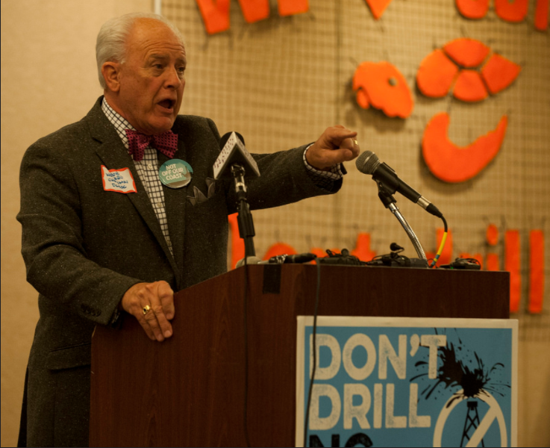
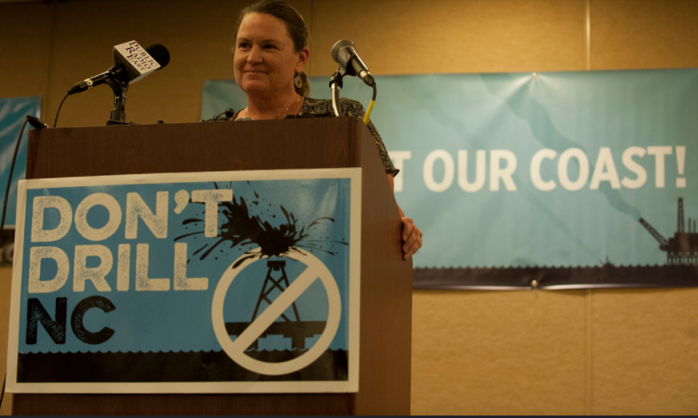
Rally to Raleigh: Press Event
Mayor Davies, Kill Devil Hills
Chairman Woodard, Dare County
Photos © Alan Cradick

Slide 46
Rally to Raleigh: Press Event
Photos © Alan Cradick

Slide 47
2019-2024 DPP Talking Points
The environmental risks of drilling in the Mid-Atlantic Planning Areas outweigh any alleged developmental benefits.
Chronic oil spills and the risk of catastrophic oil spills present too great a threat to the Atlantic Coast.
Oversight of the offshore oil and gas industry is deficient, amplifying the risks of offshore oil and gas activity in the Atlantic Planning Areas.

Slide 48
2019-2024 DPP Talking Points
Daily offshore drilling operations would result in significant pollution in the estuarine, nearshore, and offshore environments.
The direct and indirect impacts of offshore oil and gas development include, but are not limited to, noise pollution, water pollution, air pollution, onshore industrialization, and chronic or catastrophic oil spills.
Produced water and drilling muds both contain toxic pollutants such as:
Mercury, lead, chromium, barium, arsenic, cadmium, polycyclic aromatic hydrocarbons
These pollutants are toxic to marine life at high concentrations and can cause defects or impair growth at lower concentrations.
The discarded drilling muds can drastically increase the turbidity of the water column and smother benthic organisms.

Slide 49
2019-2024 DPP Talking Points
Carolina Trough (south of Cape Hatteras) has a potential to fulfill our country’s energy demand for just 36 days of oil and 246 days of natural gas.
Governor’s Scientific Advisory Panel on Offshore Energy, 2011
The American Petroleum Institute estimates the oil and gas industry would provide up to 30,000 jobs to NC. However, most are specialized positions that would be hired out of state and work offshore.
The NC tourism economy directly provides nearly 300,000 jobs.

Slide 50
Governor Cooper Commits to Clean Energy Economy to Combat Climate, Create Jobs
Executive Order No. 80 signed Oct. 29, 2018
The order affirms North Carolina’s commitment to reducing statewide greenhouse gas emissions to 40% below 2005 levels by 2025. Additionally, the order calls for an increase in registered, zero-emission vehicles (“ZEVs”) in North Carolina to at least 80,000 and a 40% reduction in energy consumption in state-owned buildings.
The North Carolina Department of Environmental Quality (DEQ) will develop a North Carolina Clean Energy Plan to encourage the use of clean energy, including wind, solar, energy efficiency, and energy storage.
The North Carolina Department of Transportation will develop a plan to accelerate the use of zero-emission vehicles across state government. Cabinet agencies will prioritize the use of ZEVs for trips that can reasonably be made with a ZEV.
DEQ will help cabinet agencies improve their energy efficiency and publicly report utility consumption.
The North Carolina Department of Commerce will support the expansion of clean energy businesses and service providers, clean technology investment, and companies with a commitment to procuring renewable energy.
All cabinet agencies will integrate climate mitigation and resiliency planning into their policies, programs and operations.

Slide 51
2018 State Legislation
New Jersey
A839 – Prohibits offshore oil and gas exploration, development, and production in State waters, and issuance of DEP permits and approvals for activities association with offshore oil and gas activities.
Florida
Amendment 9 – Prohibits drilling for the exploration or extraction of oil and natural gas beneath all state-owned waters between the mean high water line and the state’s outermost territorial boundaries.
Oregon
Executive Order 18-28 – directed state agencies to protect Oregon’s coastal economy by preventing activities associated with offshore oil and gas drilling.

Slide 52
Proposed State Legislation in 2019
Maine – Rep. Mike Devin – H.B.
New Hampshire – Sen. Martha Fuller Clark – Draft S.B.
Massachusetts – Rep. Dylan Fernandes – Draft H.B.
Rhode Island – Sen. Dawn Euer – S.B.
New York – Assembly member Felix Ortiz – H.B. (divestment) , H.B.
Georgia – Rep. Park Cannon – H.B.
Oregon – Sen. Arnie Roblan – S.B.
Hawaii – Sen. Mike Gabbard – S.B.

Slide 53
Congressional Bills Introduced in 2019
Donald McEachin, D-VA, re-introducing the Defend Our Coast Act. Co-sponsored by Walter Jones, R-NC and David Price, D-NC.
Frank Pallone Jr., D-N.J., chairman of the House Energy and Commerce Committee, introduced the Clean Ocean and Safe Tourism, or COAST, Anti-Drilling Act.
Joe Cunningham, D-S.C., introduced the Coastal Economies Protection Act.
Salud Carbajal, D-Calif., introduced the California Clean Coast Act.
David Cicilline, D-R.I., introduced the New England Coastal Protection Act.
Kathy Castor, D-Fla., introduced the Florida Coastal Protection Act.
Jared Huffman, D-Calif., introduced the West Coast Ocean Protection Act and the Stop Arctic Ocean Drilling Act.

Slide 54
National OCS Program Development Timeline
Anticipate release of Proposed Program and Draft PEIS in early 2019
90-day comment period to follow

Slide 55
Take Action
Review the 2019-2024 Draft Proposed Program
Draft a comment letter in anticipation of the Proposed Program
Contact local and state representatives
U.S. Senator Richard Burr
U.S. Senator Thom Tillis
N.C. Senator Bob Steinburg
N.C. Representative Bobby Hanig
Write a Letter to the Editor
Attend the Response Rally at Jennette’s Pier in Nags Head
Attend the BOEM Open House on May 14 at the Ramada Plaza in Kill Devil Hills

Slide 56
www.nccoast.org
637 Harbor Road
Wanchese, NC 27981
252-473-1607

Slide 57
Annual Energy Outlook 2019 with projections to 2050
January 24, 2019
www.eia.gov/aeo
#AEO2019

Slide 58
Key takeaways
EIA’s Annual Energy Outlook provides modeled projections of domestic energy markets through 2050, and it includes cases with different assumptions regarding macroeconomic growth, world oil prices, and technological progress.

Slide 59
Key takeaways from the Reference case
The United States becomes a net energy exporter in 2020 and remains so throughout the projection period as a result of large increases in crude oil, natural gas, and natural gas plant liquids (NGPL) production coupled with slow growth in U.S. energy consumption.
Of the fossil fuels, natural gas and NGPLs have the highest production growth, and NGPLs account for almost one-third of cumulative U.S. liquids production during the projection period.
Natural gas prices remain comparatively low during the projection period compared with historical prices, leading to increased use of this fuel across end-use sectors and increased liquefied natural gas exports.
The power sector experiences a notable shift in fuels used to generate electricity, driven in part by historically low natural gas prices. Increased natural gas-fired electricity generation; larger shares of intermittent renewables; and additional retirements of less economic existing coal and nuclear plants occur during the projection period.
Increasing energy efficiency across end-use sectors keeps U.S. energy consumption relatively flat, even as the U.S. economy continues to expand.

Slide 60
The United States becomes a net energy exporter after 2020 in the Reference case—

