Slide 1
EPA PFAS Community Engagement Meeting Community Panel Presentation: North Carolina Nonprofit Environmental Advocacy Groups
Fayetteville, NC August 14, 2018

Slide 2
Thank you EPA!
To the regional office of research and development (ORD) for the technical and financial support of our state and specifically our DEQ during this contamination crisis.
For providing communities this forum to learn and be heard on the impacts of PFAS contamination to people and the environment.

Slide 3
Organizations Represented

Slide 4
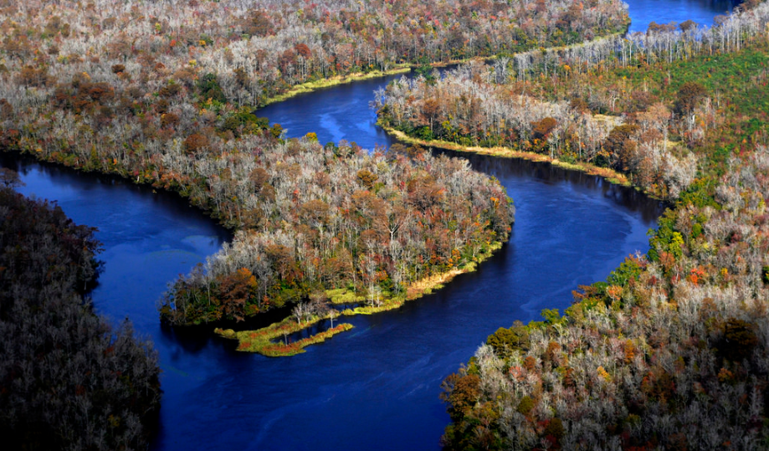
The Cape Fear River
Photo: Alan Cradick

Slide 5
Wilmington Star News, June 7, 2017

Slide 6
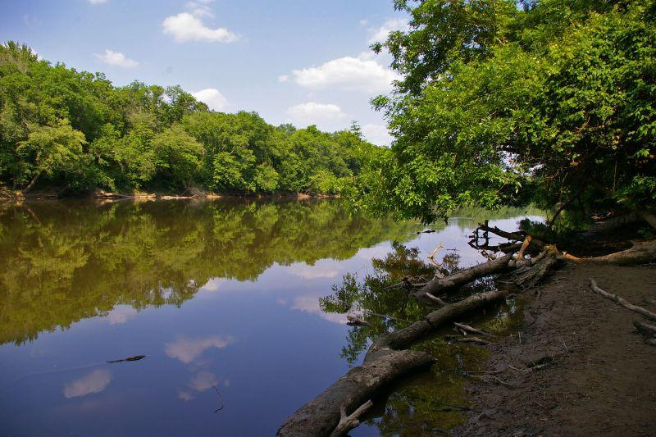
Timeline Emerges
1980- Contamination begins with Dupont
GenX as byproduct of production
2000- DuPont begins manufacture of Teflon using C8 (PFOA) at Fayetteville Works
Replaced in 2009 with GenX through EPA consent order
Credit WUNC

Slide 7
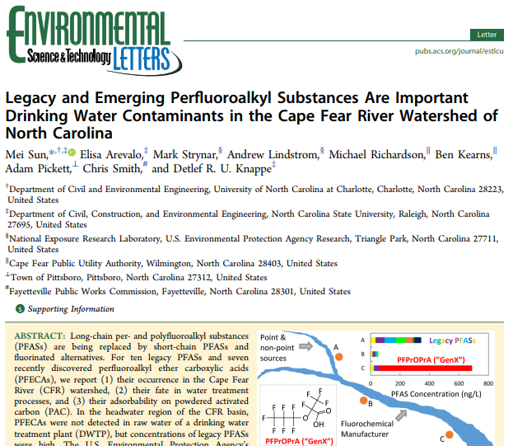
Discovery
2012- GenX first discovered in Cape Fear River, study published 2015, led by EPA scientists
2016- Sun et. al paper published, confirms GenX & 6 other PFAS in Cape Fear River
2017- The public learns of 40-year contamination of drinking water
250,000 residents

Slide 8
Airborne
Sept. 2017: DEQ/Chemours began private well testing
GenX is airborne and more than 690 private wells are contaminated.
January 2018: Chemours reports annual air emissions of 66 lb/yr of GenX.
DEQ stack testing later indicated actual emissions of 2,758 lb/yr.

Slide 9
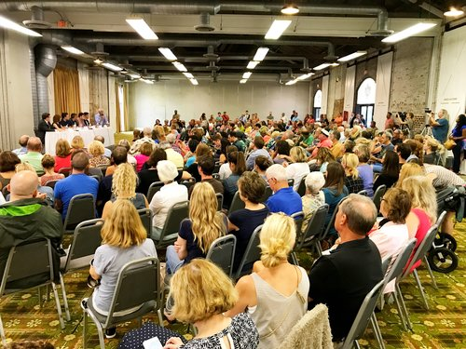
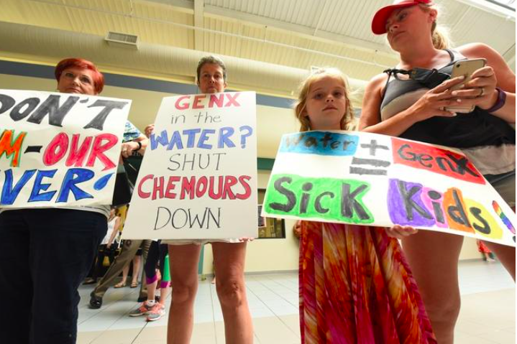
Community Response
Community meetings and rallies
Local scientists
Elected officials
Utility representatives
Information Dissemination

Slide 10
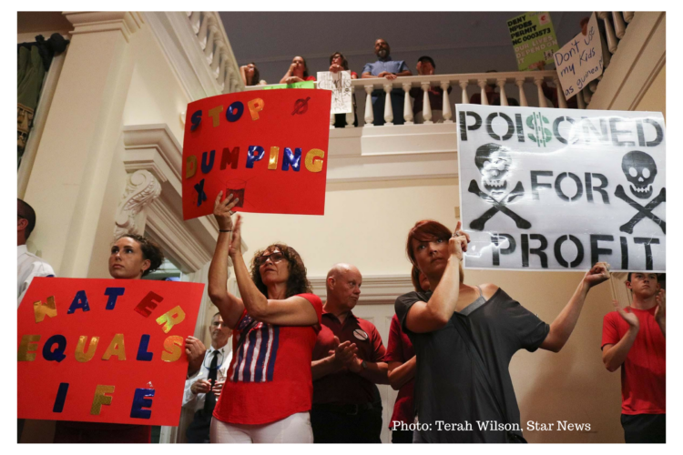
Awareness
Multiple community action groups form in Wilmington and Fayetteville areas
Several lawsuits filed
Nonprofit environmental advocates lobby for state legislative support of our underfunded DEQ
Numerous community meetings and rallies held
Hundreds of stories published in local, national media

Slide 11
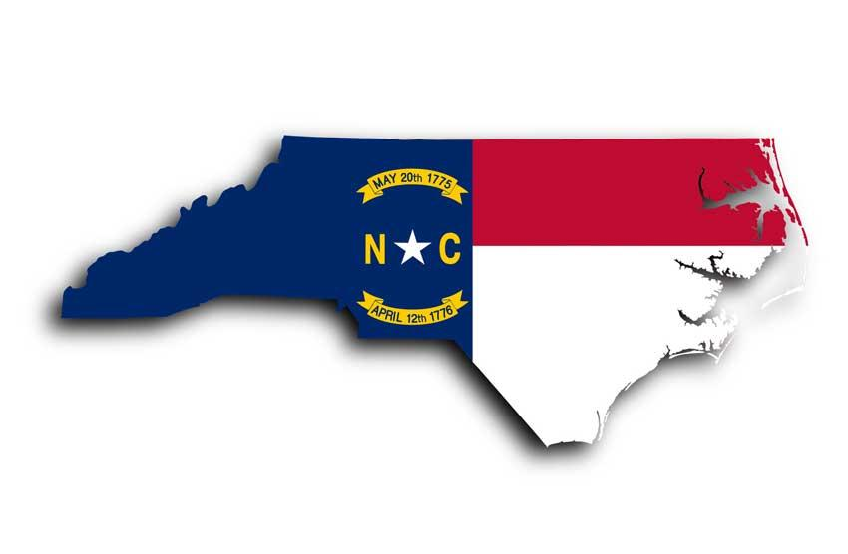
What NC Needs from the EPA
Provide interim support to states
Enforce corporate response
Prevent PFAS use in firefighting foam and gear
Prevent future contamination

Slide 12
So what does that mean?

Slide 13
Provide Interim Support to States
Consider all compounds in PFAS family as a class when determining regulatory action
Provide states with standardized PFAS test methods for surface and wastewater and lower the standard detection level to 10 ppt in accordance with health protective levels recommended by the Agency for Toxic Substances and Disease Registry (ATSDR) and the EPA

Slide 14
Provide Interim Support to States
Fully disclose extent of the PFAS problem public
Sources of PFAS contamination
Potential health effects of PFAS contamination
PFAS measurements in the environment.
Share with state regulatory bodies all data EPA has on presence of PFAS in the environment
Known or potential sources of PFAS
Industrial processes that may create PFAS as a byproduct

Slide 15
Provide Interim Support to States
Conduct a national PFAS health study
Ban any new PFAS manufacturing requests
Add PFAS chemicals to the Toxics Release Inventory
TSCA conditions applied to manufacture of a PFAS should also apply when compound is produced as byproduct

Slide 16
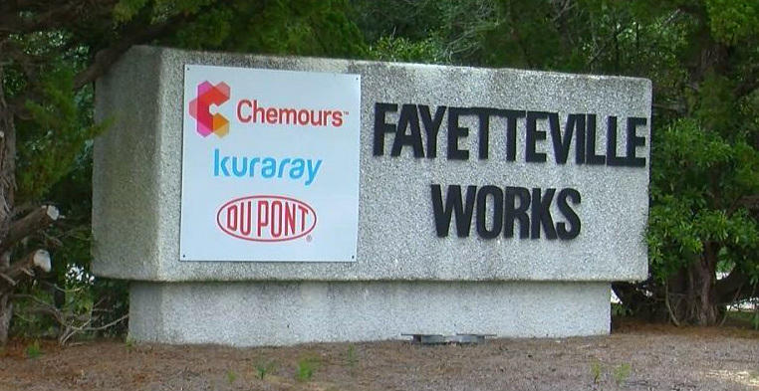
Require Corporate Responsibility

Slide 17
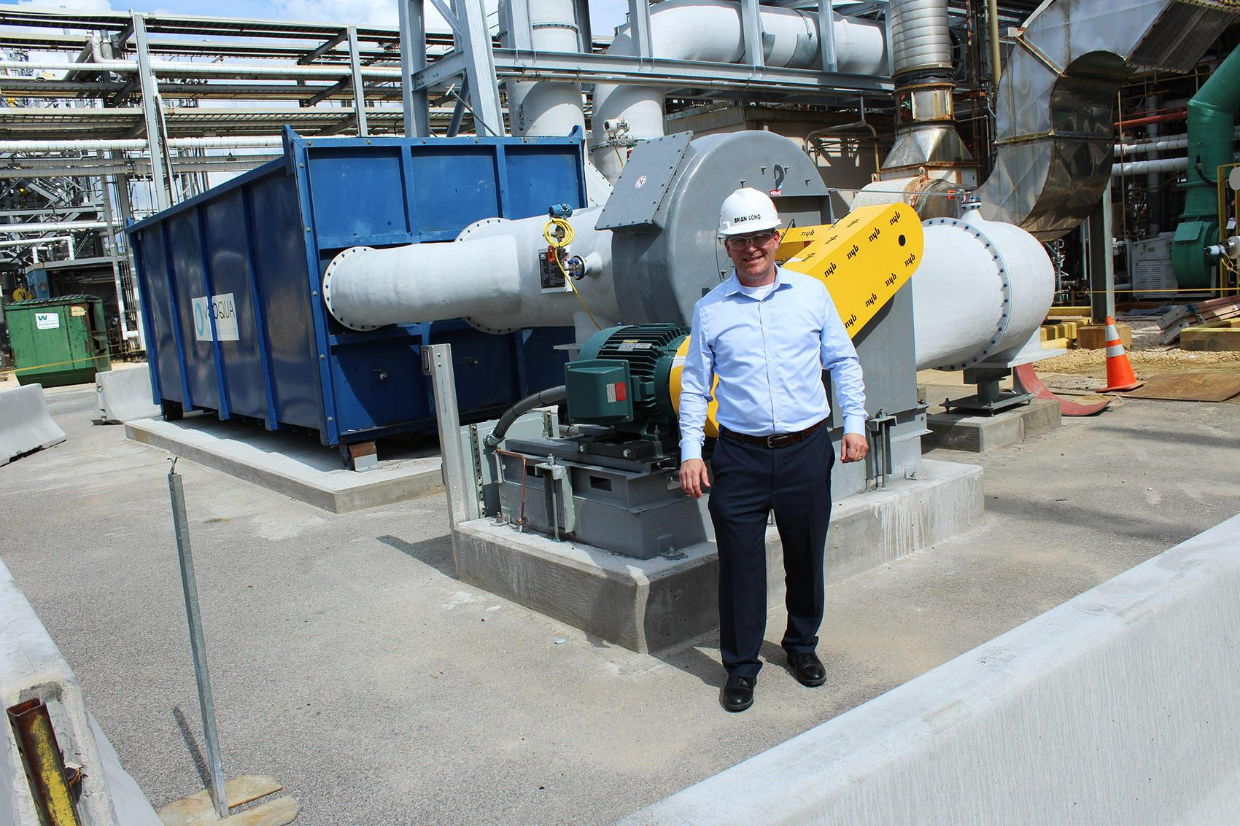
Safety Born Of Accountability
Corporations need to be good citizens
Voluntary compliance is not reasonable or effective
Laws needed to require industry to participate
Innovation
Accountability
Credit WHQR

Slide 18
Industry Participation
Ensure all discharge is reported by listing PFAS as a class as a Hazardous Substances under the Clean Water Act
Require full disclosure of all animal and human toxicological studies conducted / contracted by industry
Deny requests to substitute one PFAS with another PFAS in production
And finally...

Slide 19
Polluter Pays
Industry must be held financially responsible for environmental contamination
Remediation on and off site
Effective filtration systems at utility scale when drinking water impacted
Human health studies
Environmental sampling
Ongoing monitoring

Slide 20
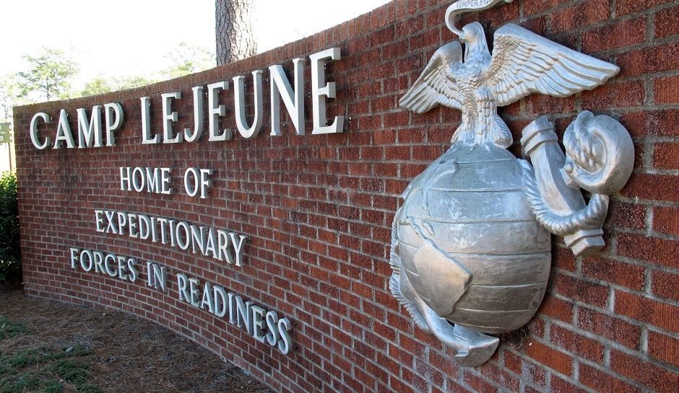
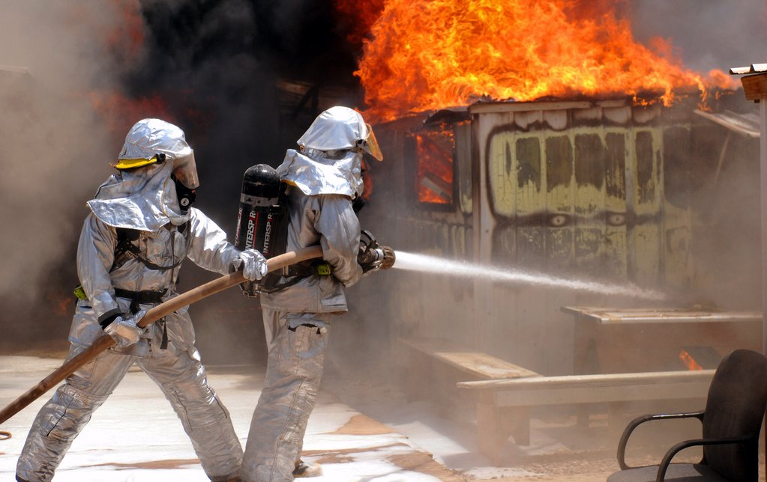
Protect Military, Firefighters and Families
Halt use of all PFAS Aqueous Film Forming Foam on bases
Halt use of PFAS in firefighting gear
Adopt same safe, effective alternatives used abroad
Eliminate industry influence in selection of materials

Slide 21
Prevent Future Contamination
Implement the internationally recognized Precautionary Principle
“When an activity raises threats of harm to human health or the environment, precautionary measures should be taken even if some cause and effect relationships are not fully established scientifically. In this context the proponent of an activity, rather than the public, should bear the burden of proof.” - Wingspread Statement on the Precautionary Principle, Jan. 1998

Slide 22
