Slide 1

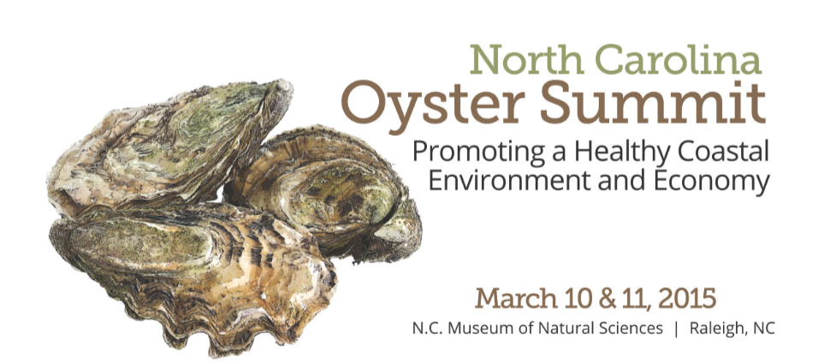
Oyster Fundamentals: What it takes to Have Productive Oyster Populations and Fisheries in North Carolina
Facilitator: Ted Wilgis, N.C. Coastal Federation
Panelists: Dr. Pete Peterson, University of North Carolina at Chapel Hill – I.M.S.
Dr. Dave Eggleston, North Carolina State University – C.M.A.S.T.
Dr. Ami Wilbur, University of North Carolina Wilmington – C.M.S.
Brian Conrad & Jason Peters, N.C. Division of Marine Fisheries
Dr. Bill Crowell, Albemarle-Pamlico National Estuary Partnership

Slide 2
Oyster Fundamentals: What it takes to Have Productive Oyster Populations and Fisheries in North Carolina
Goal of the Panel
Shared appreciation and support for the basic linked elements necessary for a healthy oyster population and viable wild fishery and mariculture industry in North Carolina

Slide 3

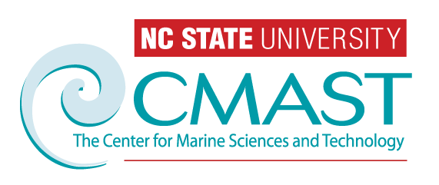

Oyster Fundamentals: What It Takes to Have Productive Oyster Populations and Fisheries in NC
Key Questions:
(1). What are the management goals of restoration?
(2). Where & How should habitats be restored?
David Eggleston
Notes:
-I’d like to begin by stating that everyone in this room has, in one way or another, probably contributed to the contents of this presentation. What follows is a methods light, results heavy compilation of empirical observations, reserve monitoring and numerical modeling simulations aimed at assessing the efficacy of reserves for oyster restoration in Pamlico Sound. From the title, you can see that there is some good news and some bad news, but before I catch the stink eye, most of this presentation highlights the positive and even “the bad” can be considered a positive to certain stakeholders. I’ve divided that talk up into three sections that correspond to three overarching program questions.

Slide 4
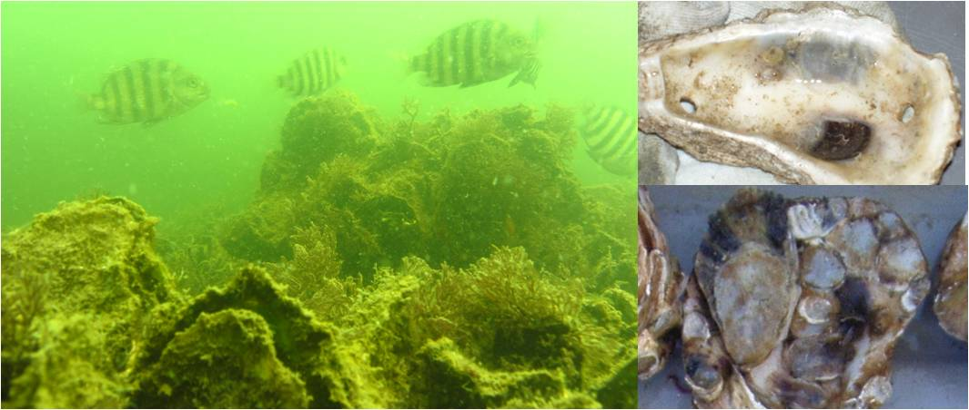
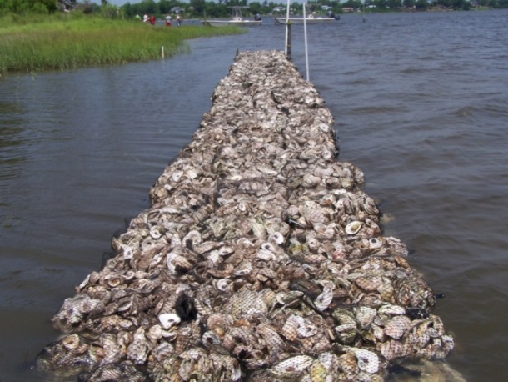
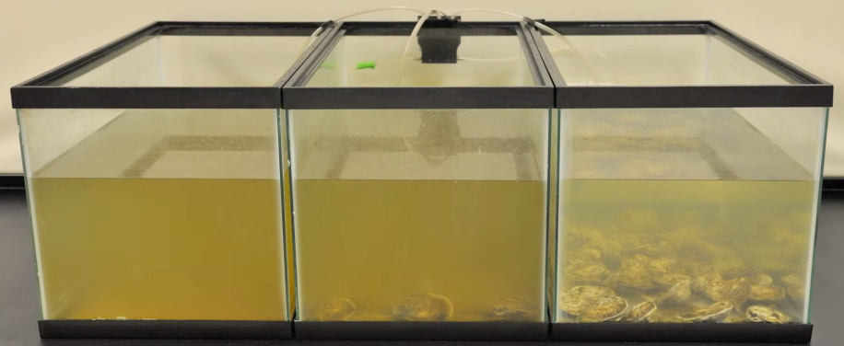
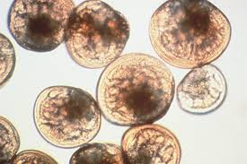
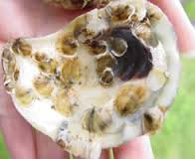
Management goals?
  1). Essential fish habitat
  2). Shoreline protection
  3). Water quality improvement
  4). Carbon sequestration
  5). “Larval insurance policy”
Credit: Nate Geraldi
0 Oysters 20 Oysters 40 Oysters
Credit: Seth Theurekauf
Notes:
To recover some of the lost ecosystem services and economic benefits associated with estuaries, we’ve begun to restore estuarine habitats.
Once specific type of estuarine habitat restoration that is the focus of my dissertation research is oyster reef restoration.
Oysters and their associated reef habitats have been decimated globally to less than 10% of their historic abundance.
However, oysters provide essential ecosystem services to estuaries including:
Essential fish habitat
Water filtration
Shoreline stabilization

Slide 5
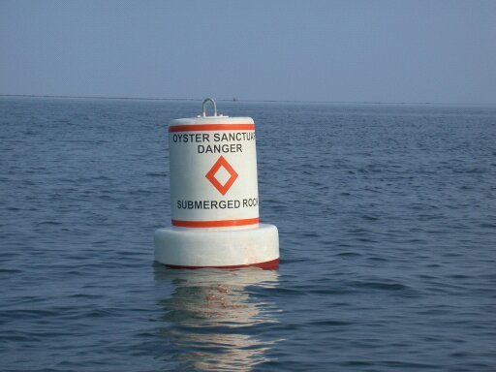
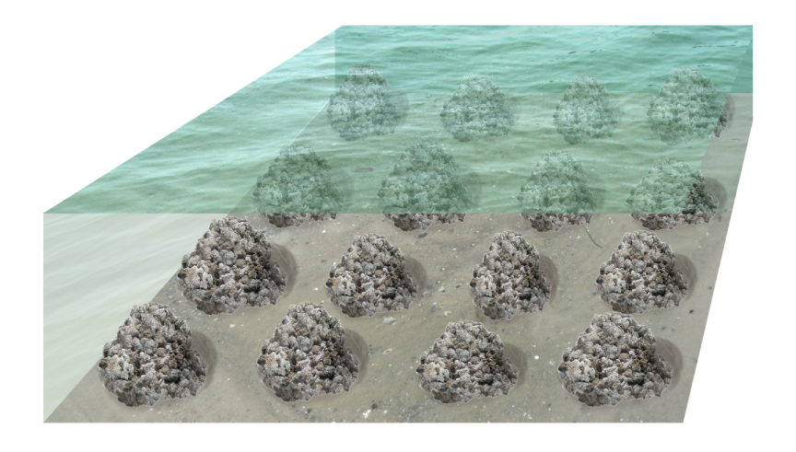
NC DMF Management Goal:
Create a self-sustaining network of broodtsock reserves
“Larval insurance policy”
Notes:
-I’d like to begin by stating that everyone in this room has, in one way or another, probably contributed to the contents of this presentation. What follows is a methods light, results heavy compilation of empirical observations, reserve monitoring and numerical modeling simulations aimed at assessing the efficacy of reserves for oyster restoration in Pamlico Sound. From the title, you can see that there is some good news and some bad news, but before I catch the stink eye, most of this presentation highlights the positive and even “the bad” can be considered a positive to certain stakeholders. I’ve divided that talk up into three sections that correspond to three overarching program questions.

Slide 6
a
b
c
d
e
f
g
h
i
j
Credit: A. Haase & B. Puckett
* Potential Settlement Areas
from 10 Oyster Sanctuaries
* Location matters!

Slide 7
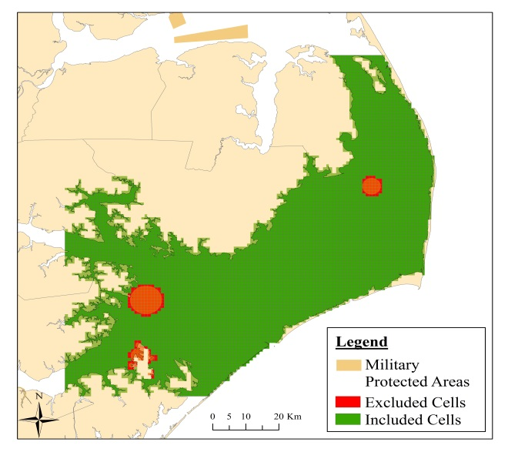
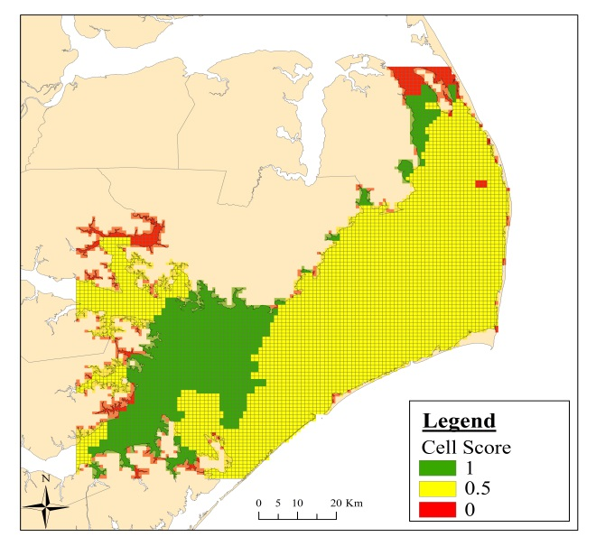
Where should reserves be built?
GIS Approach
  Created grid of Pamlico Sound (6,041 km² cells)
  Conducted larval dispersal simulations
  Assembled 16 GIS layers
  Two categories: exclusion and threshold
  Calculated suitability value of all cells
    Scale: 0 (unsuitable) to 1 (most suitable)
Exclusion: Military zones
Salinity (30%)
Threshold: Salinity

Slide 8
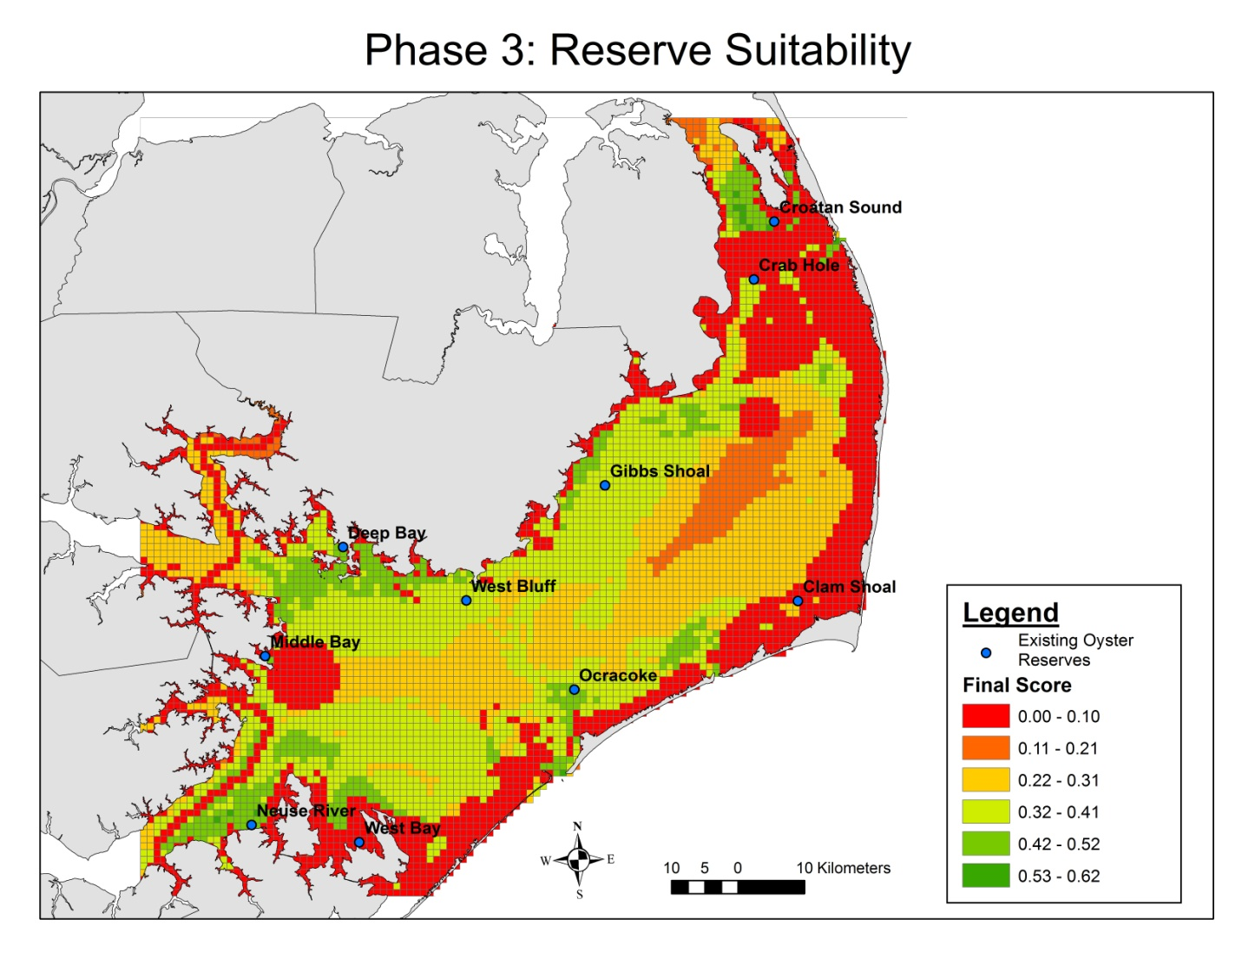
Where should reserves be built?
Credit: B. Puckett & R. Guajardo
Reserve Suitability
37% of Pamlico Sound unsuitable
Optimal sites clustered in SW and NE portions of PS
Integrates biological & economic considerations
Must ground-truth & know biology

Slide 9
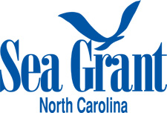
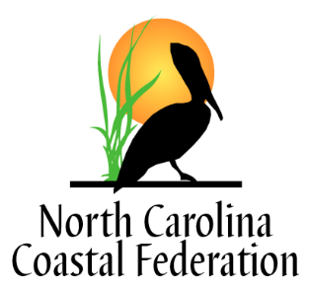
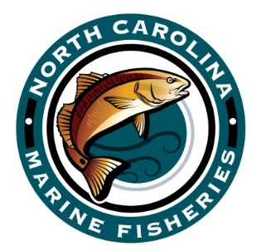
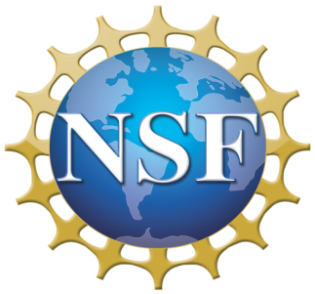
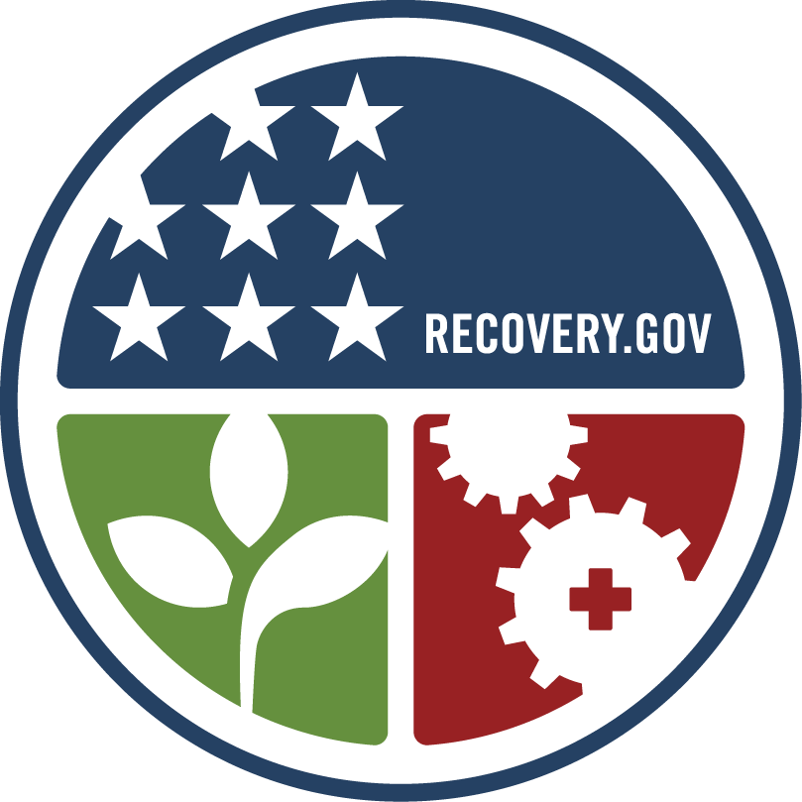
Questions for Discussion
Can we optimize location among different management goals?
Can we develop a decision-support tool to guide restoration?
Is there support for monitoring?
-Test if restoration met goals
- Refine decision support tool
Notes:
9

Slide 10

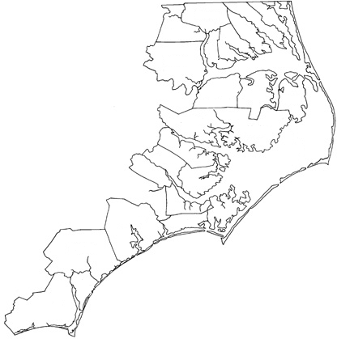
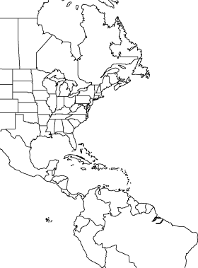
Are oysters in NC genetically differentiated ?
North Carolina
Coast wide, ~3 regional assemblages (Wakefield & Gaffney 1996, Hoover & Gaffney 2006, Gaffney 2006)
Wanchese
Crab Hole
West Bluff
Deep Bay
Buxton
Ocracoke
White Oak
New River
Kings Creek
Hewletts Creek
In-state, Pamlico and Southeastern estuaries differentiated (Sackett 2002, Wilbur unpub. data)
Range of Crassostrea virginica

Slide 11

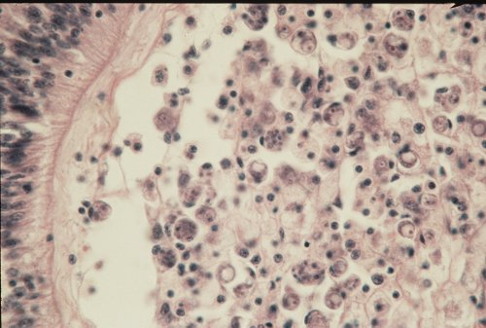
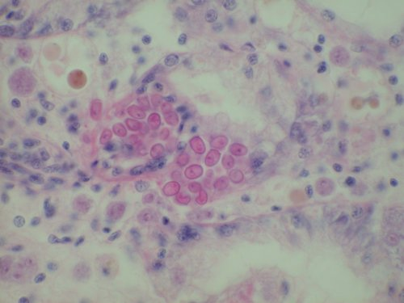
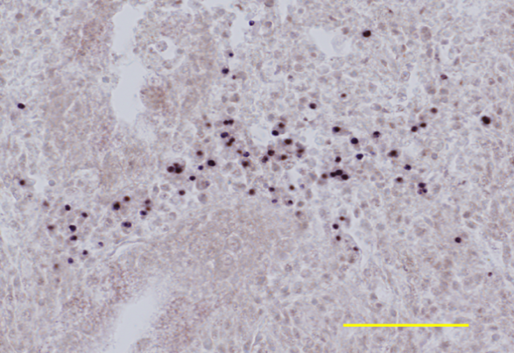
What are the oyster disease challenges?
 |  | Percent qPCR Positive
 |  | “DERMO” | “MSX”
CS | Crab Slough | 95 | 100
CH | Crab Hole | 98 | 93
LS | Long Shoal | 94 | 83
PR | Pamlico River | 54 | 76
DB | Deep Bay | 100 | 90
WB | West Bluff | 100 | 97
BX | Buxton | 67 | 47
OC | Ocracoke | 94 | 76
WE | West Bay | 98 | 87
TB | Turnagain Bay | 83 | 85
SO | South River | 90 | 93
NO | North River | 36 | 97
NP | Newport River | 91 | 86
CB | Courthouse Bay | 83 | 73
VC | Virginia Creek | 95 | 90
GF | Galloway Flats | 67 | 42
CS
CH
Parasite
Prevalence
2009 sample sites
LS
DB
WB
PR
BX
TB
WE
SO
OC
NO
NP
CB
VC
Haplosporidium nelsoni
Bonamia sp.
Perkinsus marinus
GF
Parasite photos: VIMS shellfish pathology lab

Slide 12
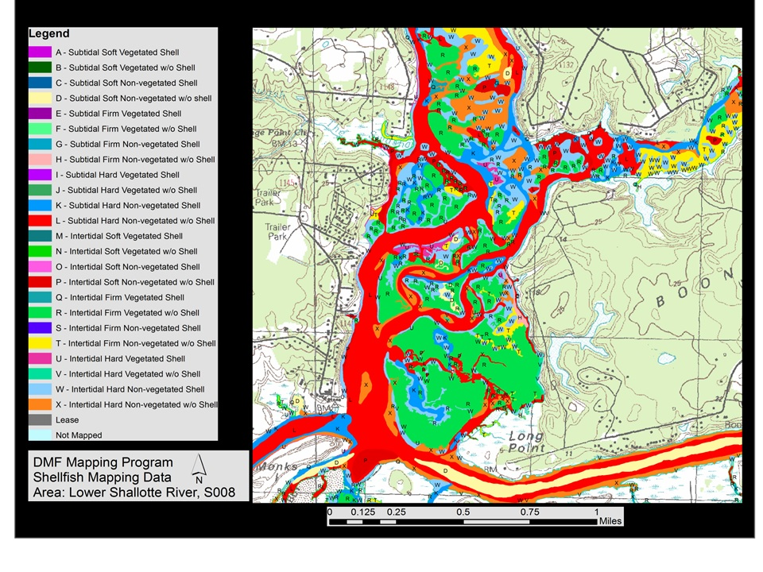
NCDMF Shellfish Mapping Program
Locate and map shellfish producing areas and Submerged Aquatic Vegetation (SAV).
Delineate potentially productive bottom.
Determine shellfish concentrations and abundance within productive bottom types by a stratified random sampling scheme.
Quantify habitat types.

Slide 13
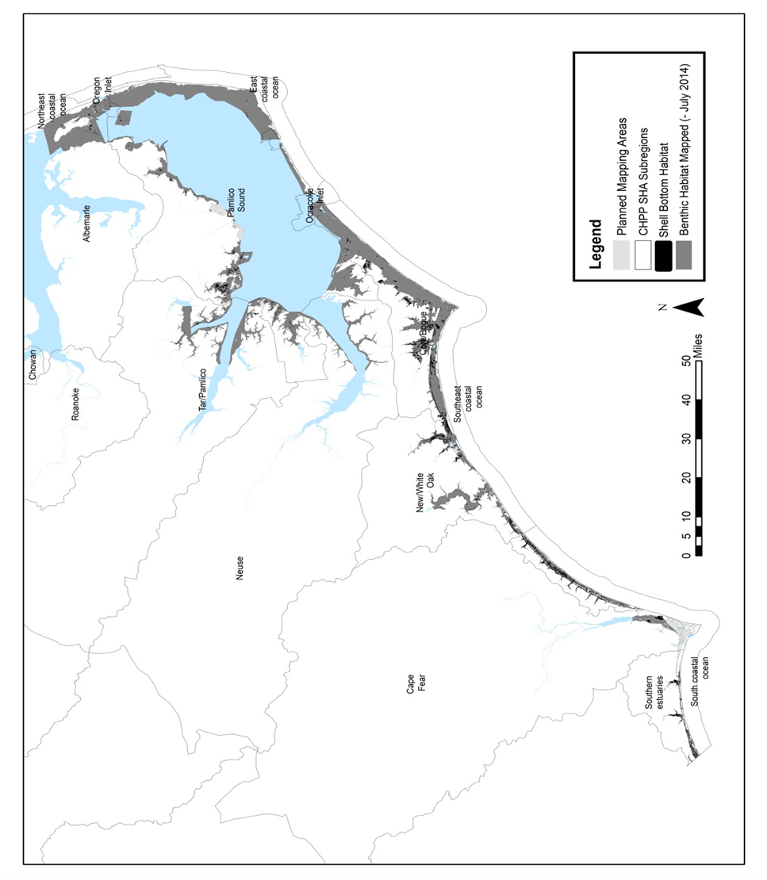
NCDMF Shellfish Mapping Program
Notes:
Over 590,000 acres have been mapped, of that 21,000 is shell habitat. The deepwater mapping effort, the area in blue is the approximately 920,000 acres in depths greater than 15 feet exist. Since program cuts in 2011, little deepwater mapping has occurred.

Slide 14
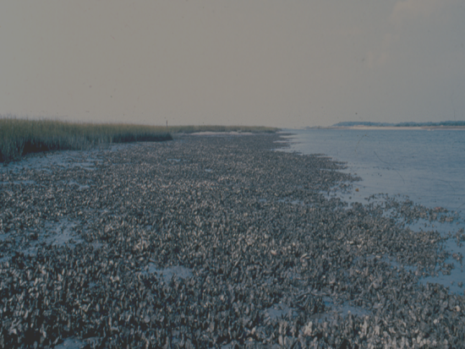
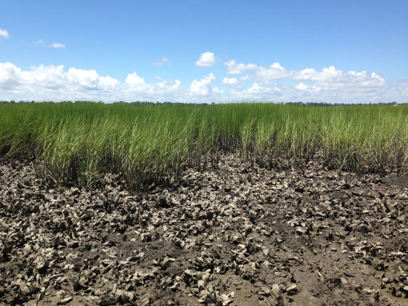
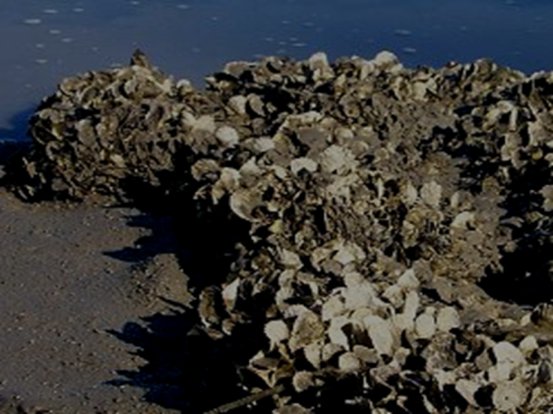
NCDMF Shellfish Mapping Program

Slide 15
Wild Harvest
Stock Status
NOAA (National): Insufficient data
Academia (National, Zu Ermgassen 2012): Significant loss of natural habitat
NCDMF (Statewide): Concern
Notes:
Figure: trend of decline through the mid 90s, then gradual increase in harvest since. Peak in 2010 from change in harvest provisions set fmp supplement on dredge restrictions 2010
Dmf status report: based on consistent harvest, but listed as concern for lack of available data
Landings statistics (time series)
Status of fishery (defined by NOAA and defined by DMF and scientific perspective (zu ermgassen, beck, etc)

Slide 16
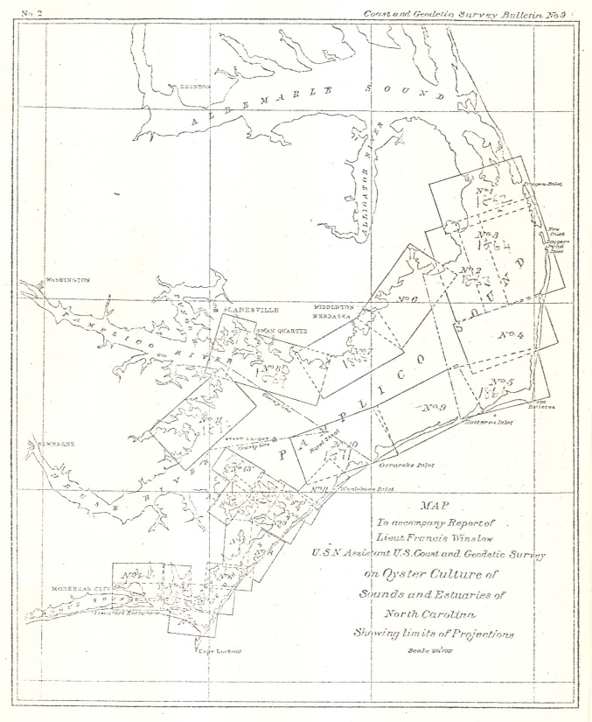
Natural Subtidal Oyster Bottom
Winslow 1886: ~10,000 acres
DMF Estimate: ~3,877 acres mapped so far
Peters (in review) Estimate: ~6,500 Acres
Notes:
This is strictly for Pamlico Sound
Describe as mostly low relief, low population density

Slide 17
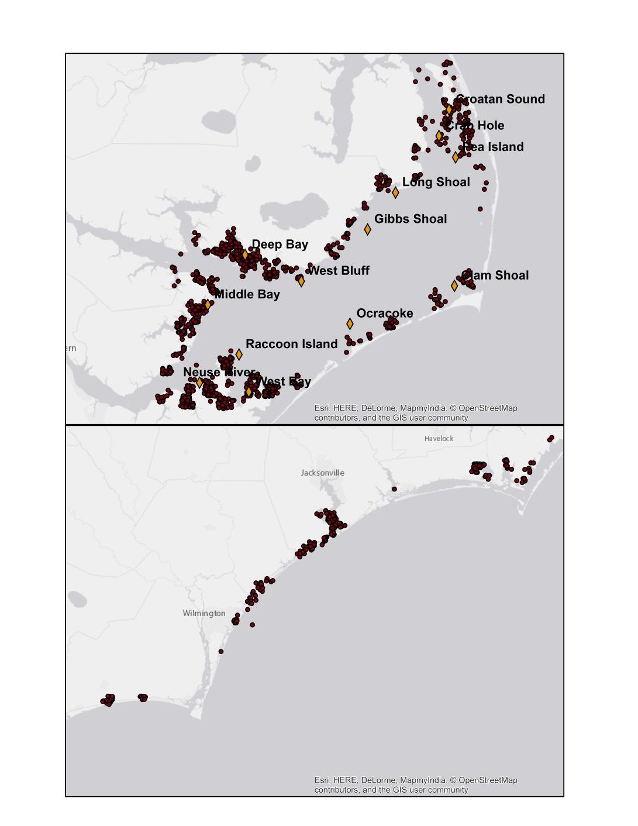
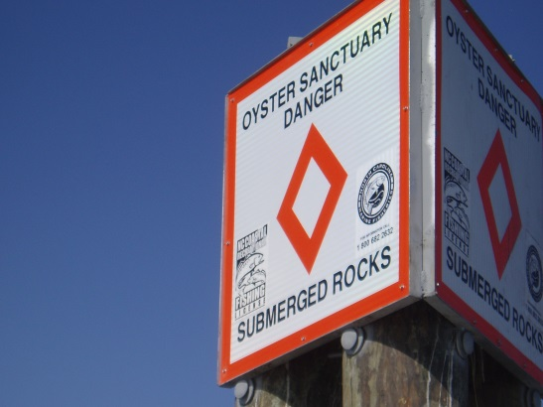
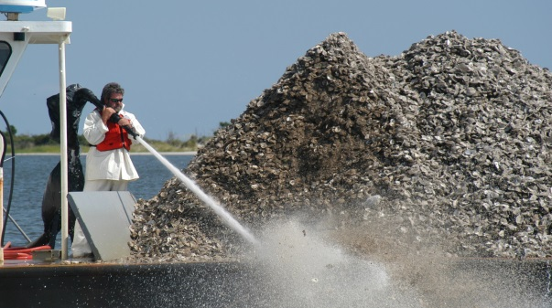
Restored/Created Oyster Bottom
Cultch Planting Program
Since 1915
1,607 sites since 1981
9,637,727 bushels since 1982
Open to public harvest
Oyster Sanctuary Program
Since 1996
13 established sites
309 acres established
6 additional planned
  ~200 acres
Closed to oyster harvest

Slide 18
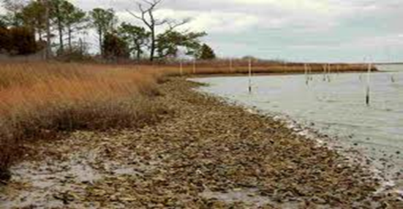
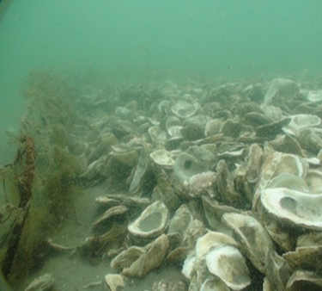
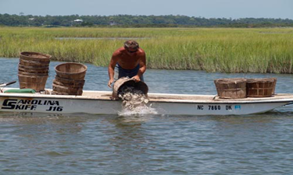
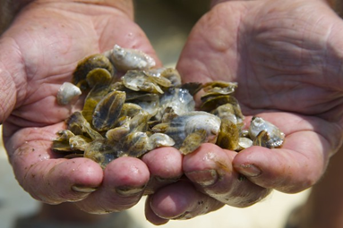
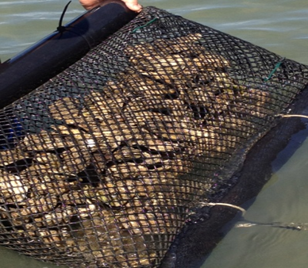
North Carolina’s
Shellfish Lease Program History
The State of North Carolina has provided for the private use of public trust waters to North Carolina residents for the commercial production of shellfish on leased bottom since 1858.
February 2015: 182 shellfish leases existed on 1208 acres.
In 1989 legislation was enacted to allow the use of the water column above existing shellfish leases. The first water column lease was issued in 1991.
1998 – 7 water columns
2012 – 16 water columns
2015 – 25 water columns

Slide 19
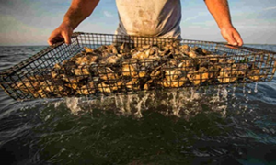
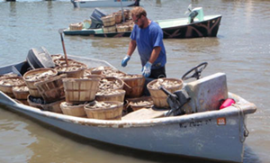
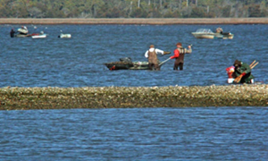
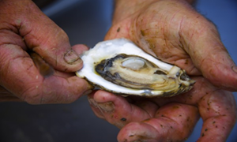
North Carolina Shellfish Lease Program
Shellfish Water Column Lease
Shellfish Bottom Lease
Shellfish Franchise

Slide 20
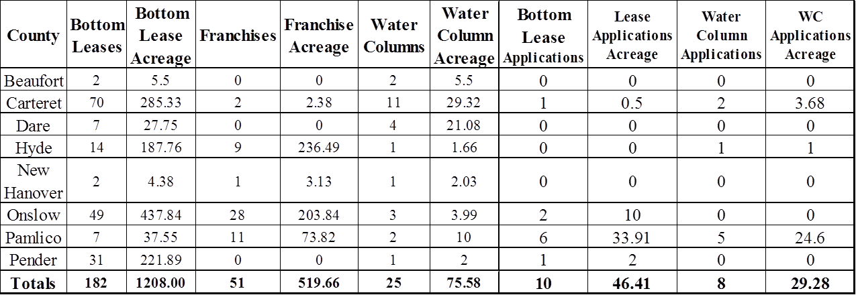
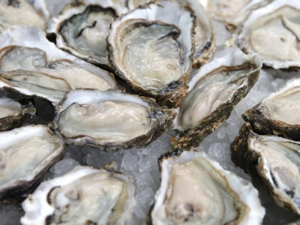
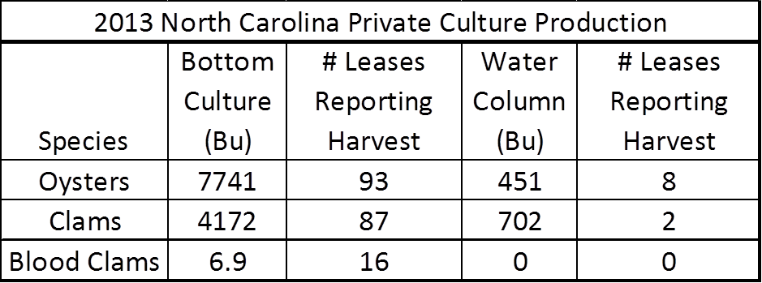
North Carolina Shellfish Lease Program

Slide 21
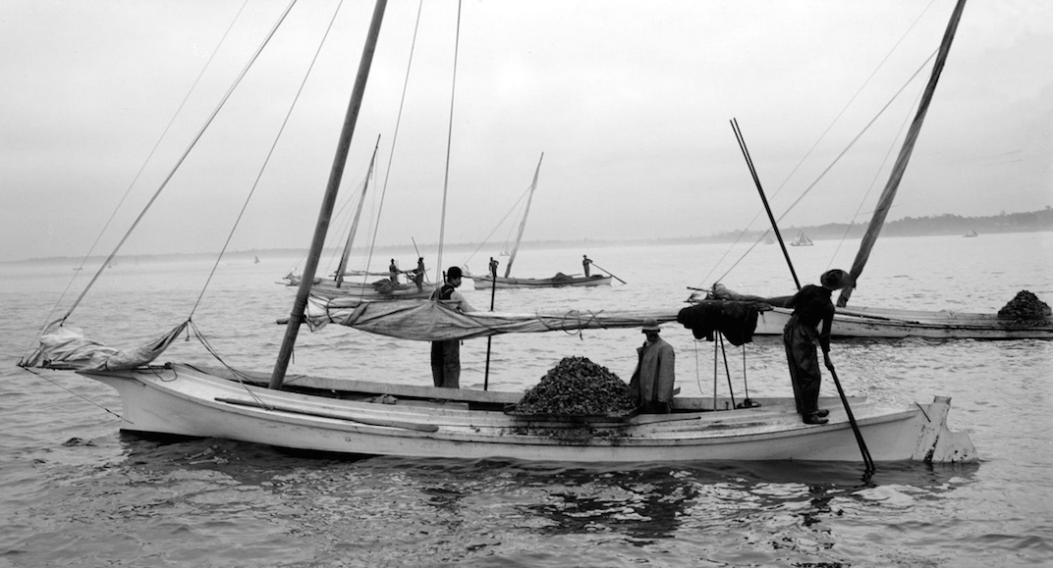
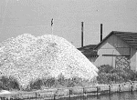
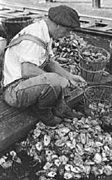
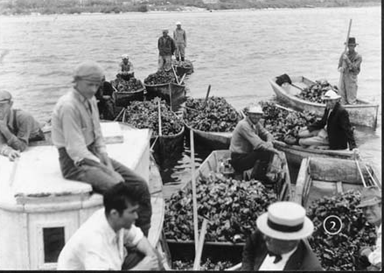
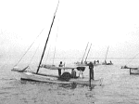
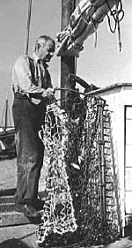
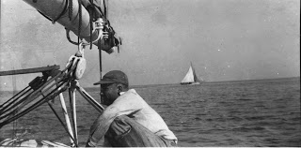

Slide 22









Slide 23


















Innovative Thinking

Slide 24
Abundant oysters support healthy coastal waters.
Healthy coastal waters support healthy local economies.
Healthy local economies support robust regional economies.
Abundant oysters support livable human communities.

